Slide 1
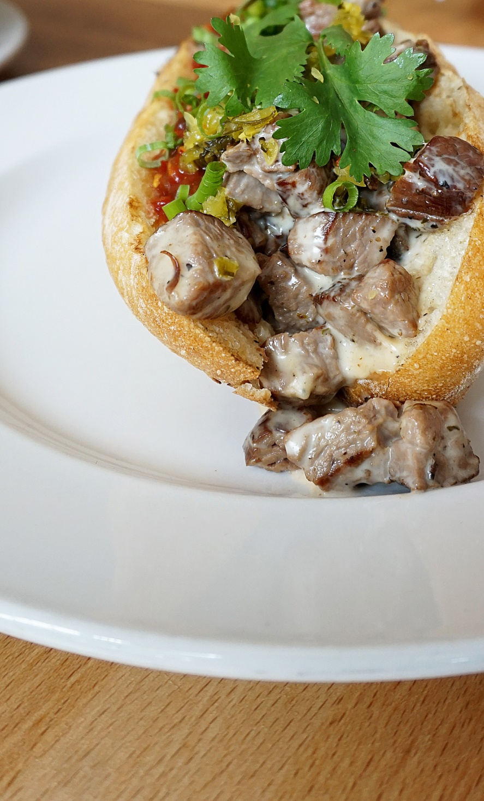
Danielle N. Salmon
Chief Eating Officer
February 22, 2017
Status Kuo in Mar Vista

Slide 2
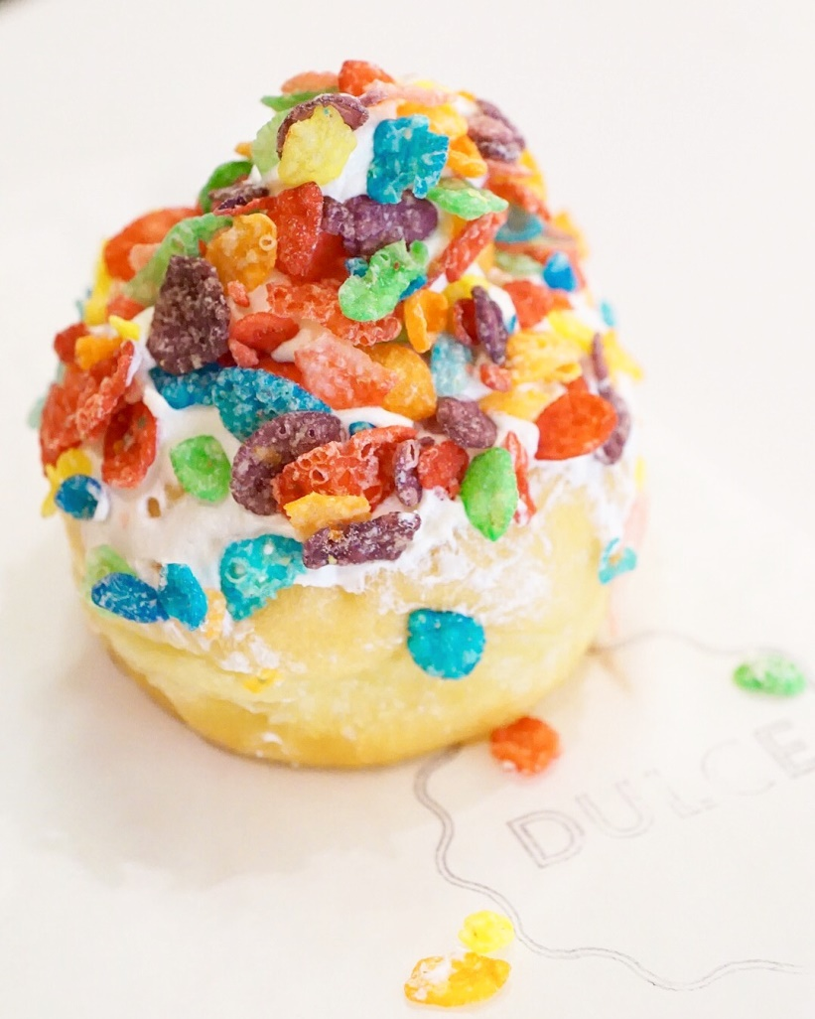
What is She Gonna Talk About??
A Girl, Her Gut, and a Blog
The Fun Stuff
I Get Around (Where I’ve Been)
Creating Your Brand
Hobby vs. Business
Photography
Social Media Marketing
What No One Tells You
Café Dulce in Downtown Los Angeles

Slide 3
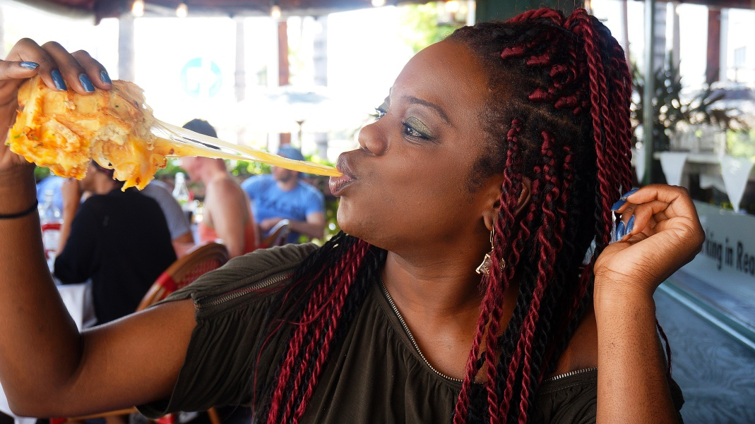
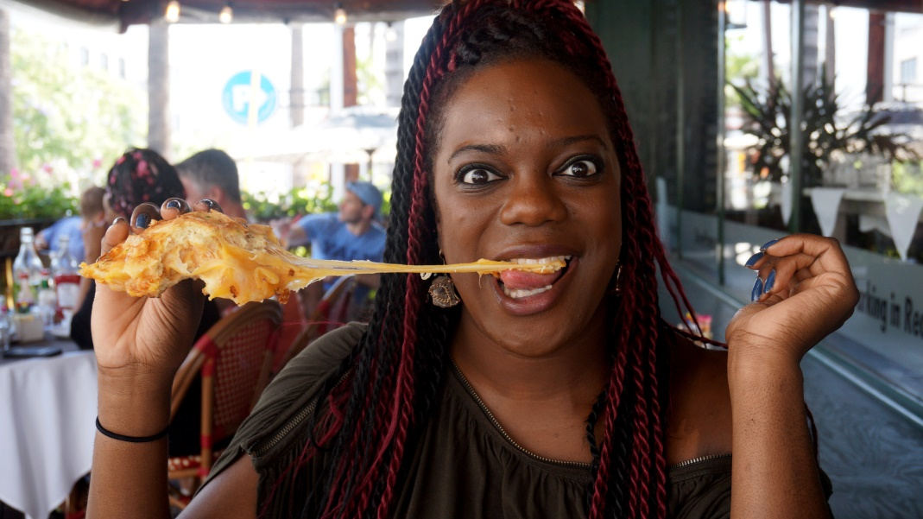
A Girl, Her Gut, and a Blog
Follow My Gut www.FollowMyGut.com
@FollowMyGut ( )
A restaurant discovery site based in Los Angeles with global coverage
Started December 21, 2104
200+ restaurant, event, and brand reviews
Went from 165 to 180 pounds
WeHo Bistro in West Hollywood

Slide 4
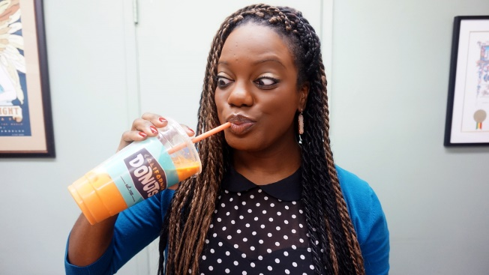
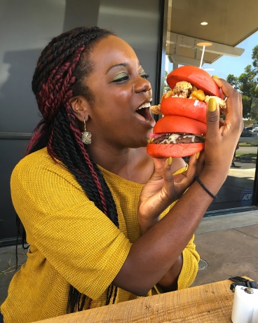
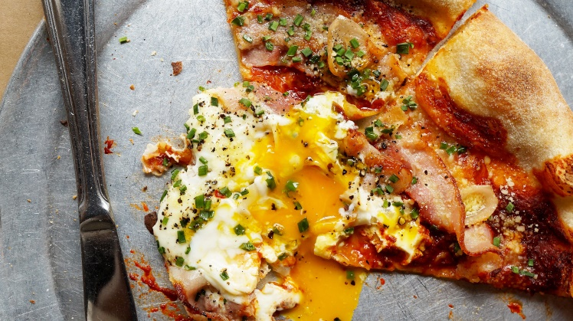
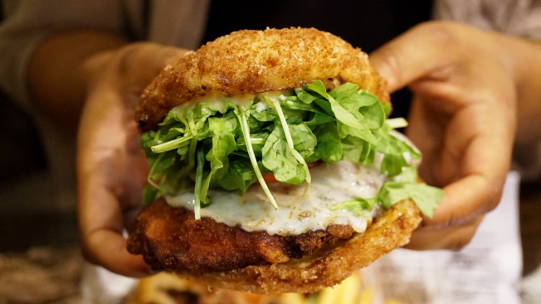
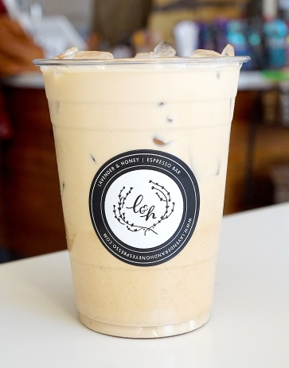
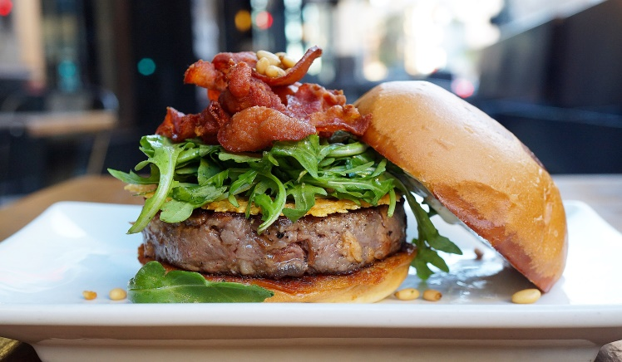
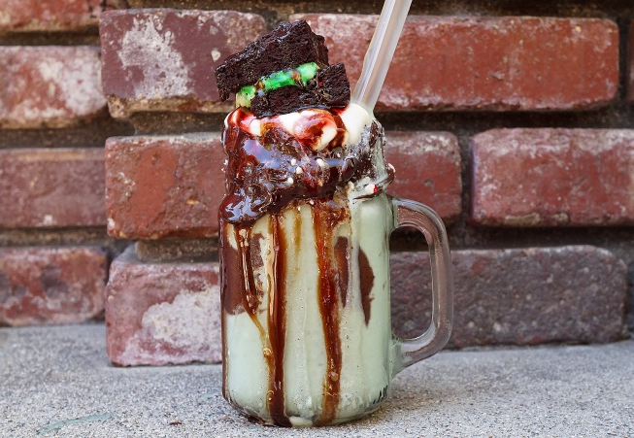
The Fun Stuff
Photography
Restaurant Reviews
Social Media Promotion

Slide 5
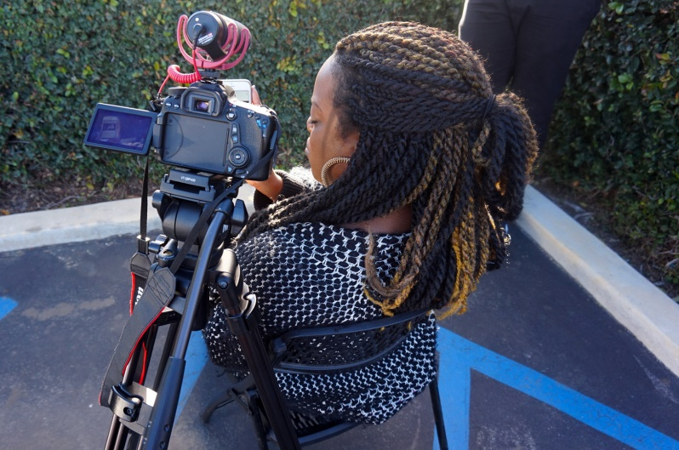
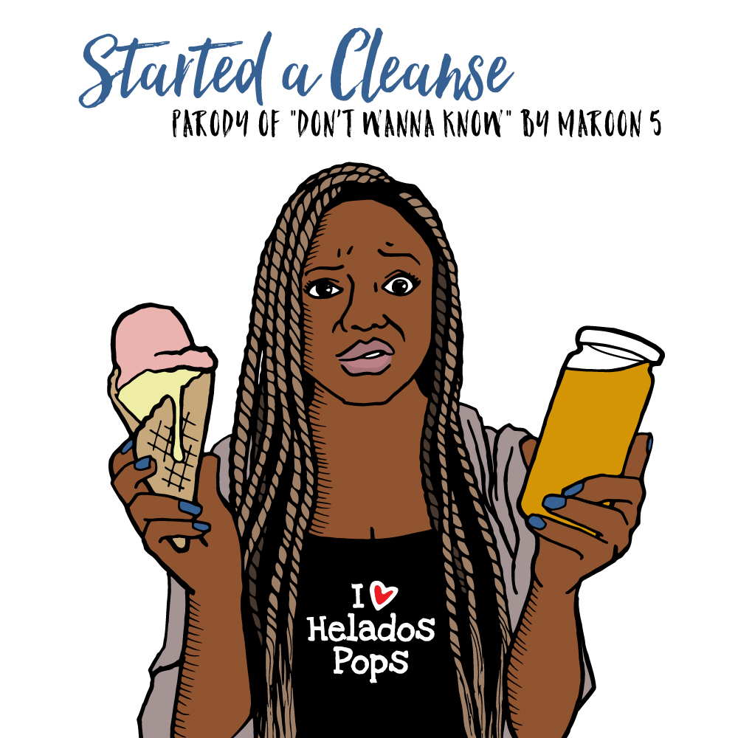
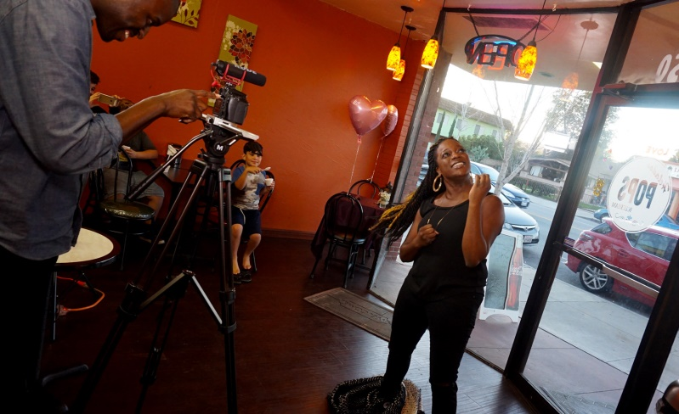
The Fun Stuff
Music
Music Videos

Slide 6
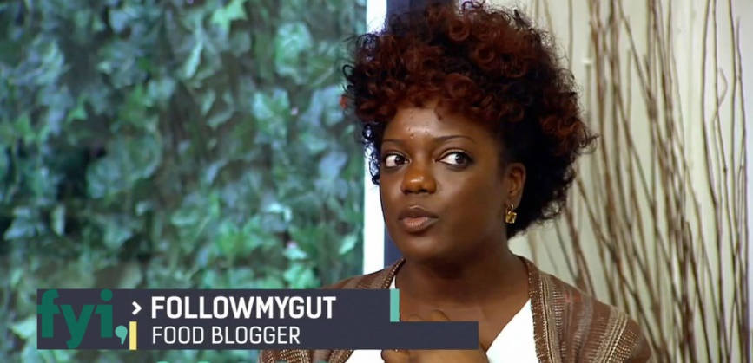
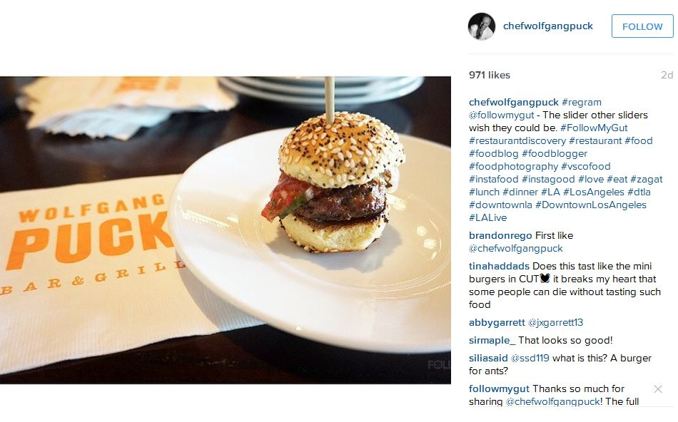
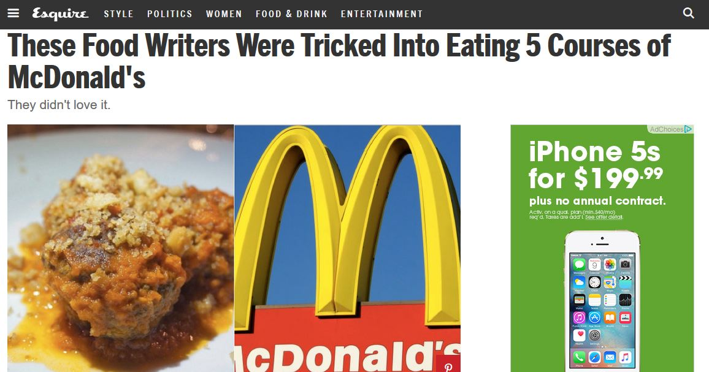
I Get Around (Where I’ve Been)
Partnered with Los Angeles Magazine, Thrillist, LA Weekly, OC Night Market, and more.
Four Seasons Hotel Mexico City, Grand Mercure Hotel Phuket.
Appeared on FYI’s “Say it To My Face”.
Mentioned in Esquire, Cosmopolitan, Hello Giggles, and more.

Slide 7
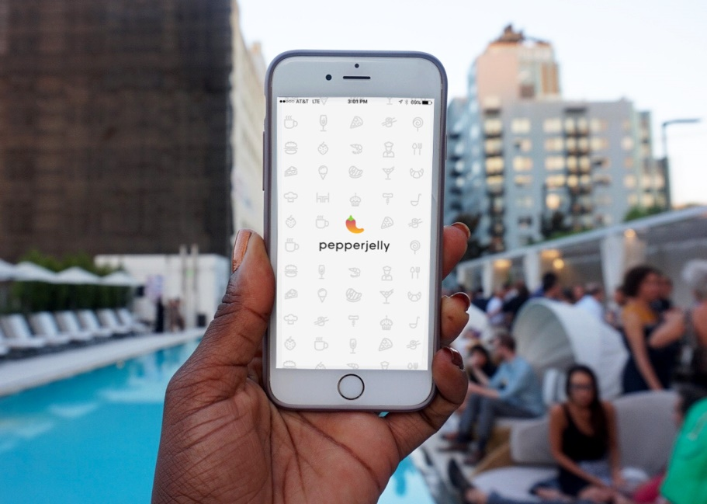
Creating Your Brand
Your Hobby vs. Your Business
What do you want to do?
Fashion? Music? Food? Art? Juggler?
Decide whether you want to do something in your spare time (hobby) or something you want to make a living on.
Choose a name, personality, and interactions with others.
Decide where you want to be online and in social media.
PepperJelly App via App Store

Slide 8
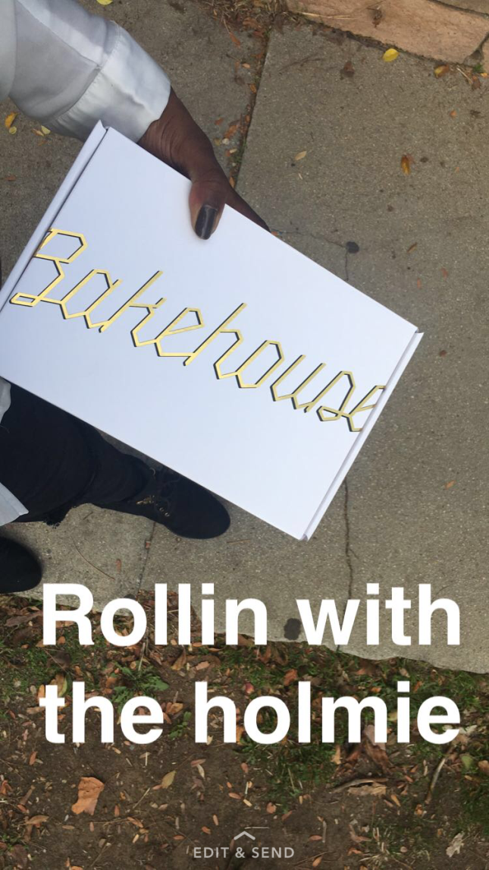
Creating Your Brand
Social Media Marketing
Which social media platforms should you use?
What you should and shouldn’t post?
Helpful Tools and Websites
Canva
Creative Live
Later.com
Buying followers vs. organic growth

Slide 9
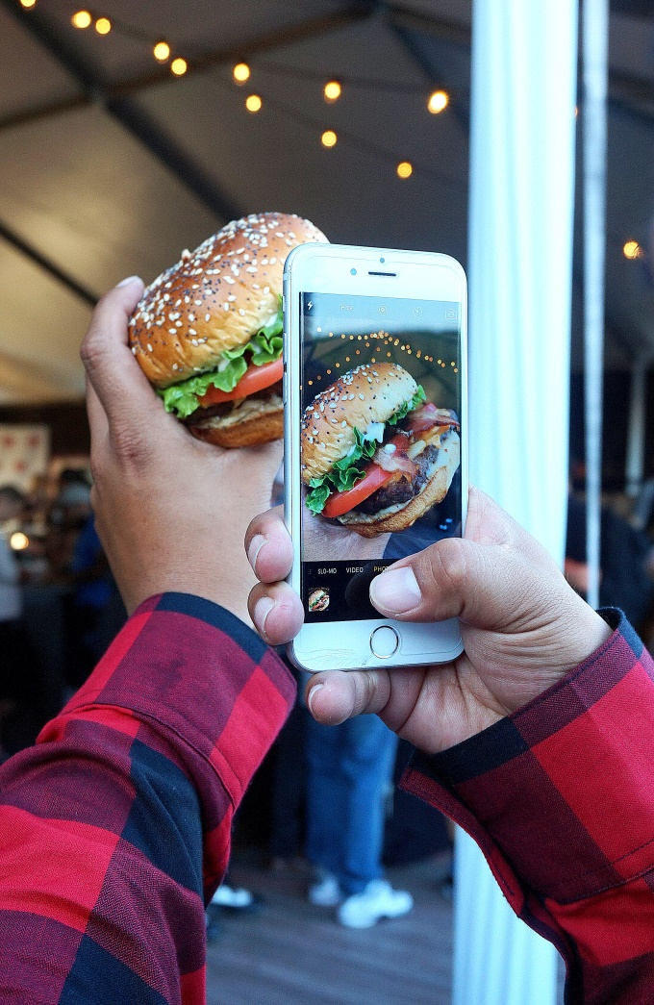
Creating Your Brand
Photography
What kind of photos do you like?
Dark or light? Bubbly or gothic?
What kind of equipment do you need?
Photoshop, tripod, microphone, lights, chargers
How many photos should you take?
Where will you post your photos?
Jack in the Box Headquarters in San Diego

Slide 10
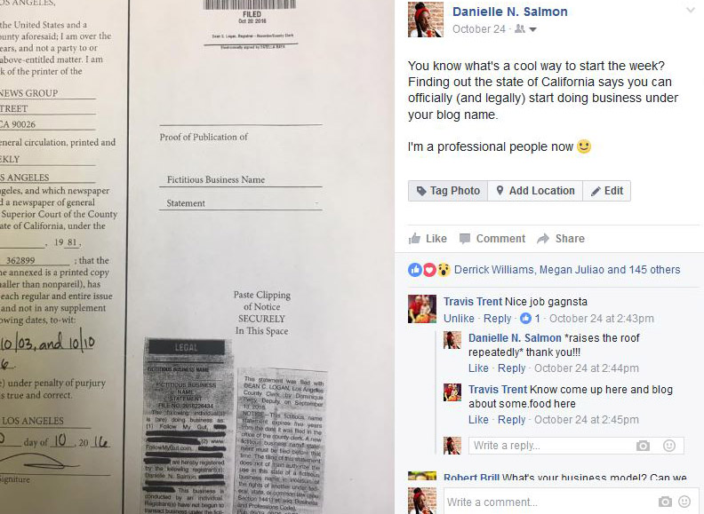
What No One Tells You
You’re going to be exhausted.
(Get used to it)
Your friends will be pissed.
(Your true friends will understand)
You’ll compare yourself to others. (Try not to do that)
It will get expensive.
(That’s normal)
Befriend people with skills you don’t have
(It’ll come in handy)
Your efforts won’t make sense in the beginning
(Wait on it)
Facebook

Slide 11
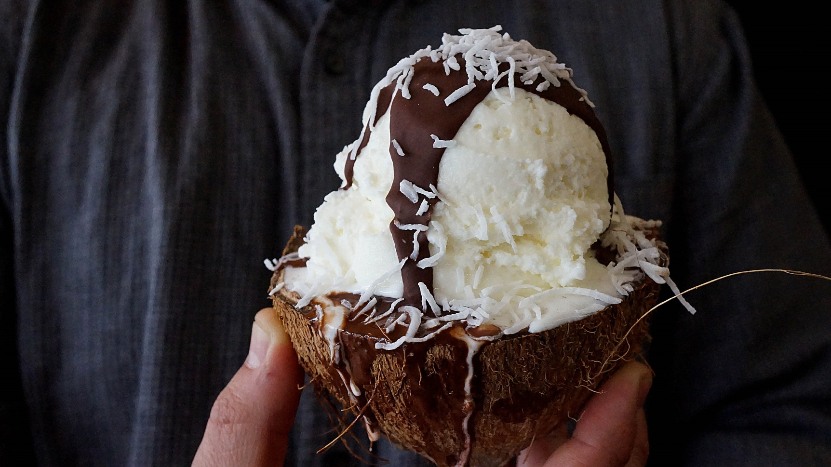
Thank You!
Questions x Comments?
Helados Pops and Ice Cream in San Fernando

