Slide 1
WHAT IS YOUR DREAM?

Slide 2
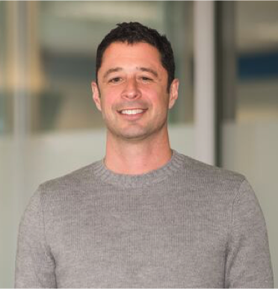
LEADERSHIP & BUSINESS

Slide 3
LEADERSHIP & BUSINESS
Adam Piandes

Slide 4
LEADERSHIP & BUSINESS
Adam Piandes
Leadership & Biz Coach

Slide 5
LEADERSHIP & BUSINESS
Adam Piandes
Leadership & Biz Coach
I.C.F

Slide 6
LEADERSHIP & BUSINESS
Adam Piandes
M.A Spiritual Psychology
Leadership & Biz Coach
I.C.F

Slide 7
LEADERSHIP & BUSINESS
Adam Piandes
M.A Spiritual Psychology
Leadership & Biz Coach
College basketball
I.C.F

Slide 8
LEADERSHIP

Slide 9
WHAT MAKES YOU A GREAT LEADER?

Slide 10
BELIEVE
WHAT MAKES YOU A GREAT LEADER?

Slide 11
BELIEVE
WHAT MAKES YOU A GREAT LEADER?
DEVELOPMENT

Slide 12
BELIEVE
WHAT MAKES YOU A GREAT LEADER?
DEVELOPMENT
HEART-FELT

Slide 13
BELIEVE
WHAT MAKES YOU A GREAT LEADER?
DEVELOPMENT
HEART-FELT
PRACTICE

Slide 14
YOUR BUSINESS

Slide 15
Entrepreneur:
Someone who jumps off a cliff and builds a plane on the way down

Slide 16
WHY LEADERSHIP?

Slide 17
THIS GOT ME HERE

Slide 18
AND SO DID THIS

Slide 19
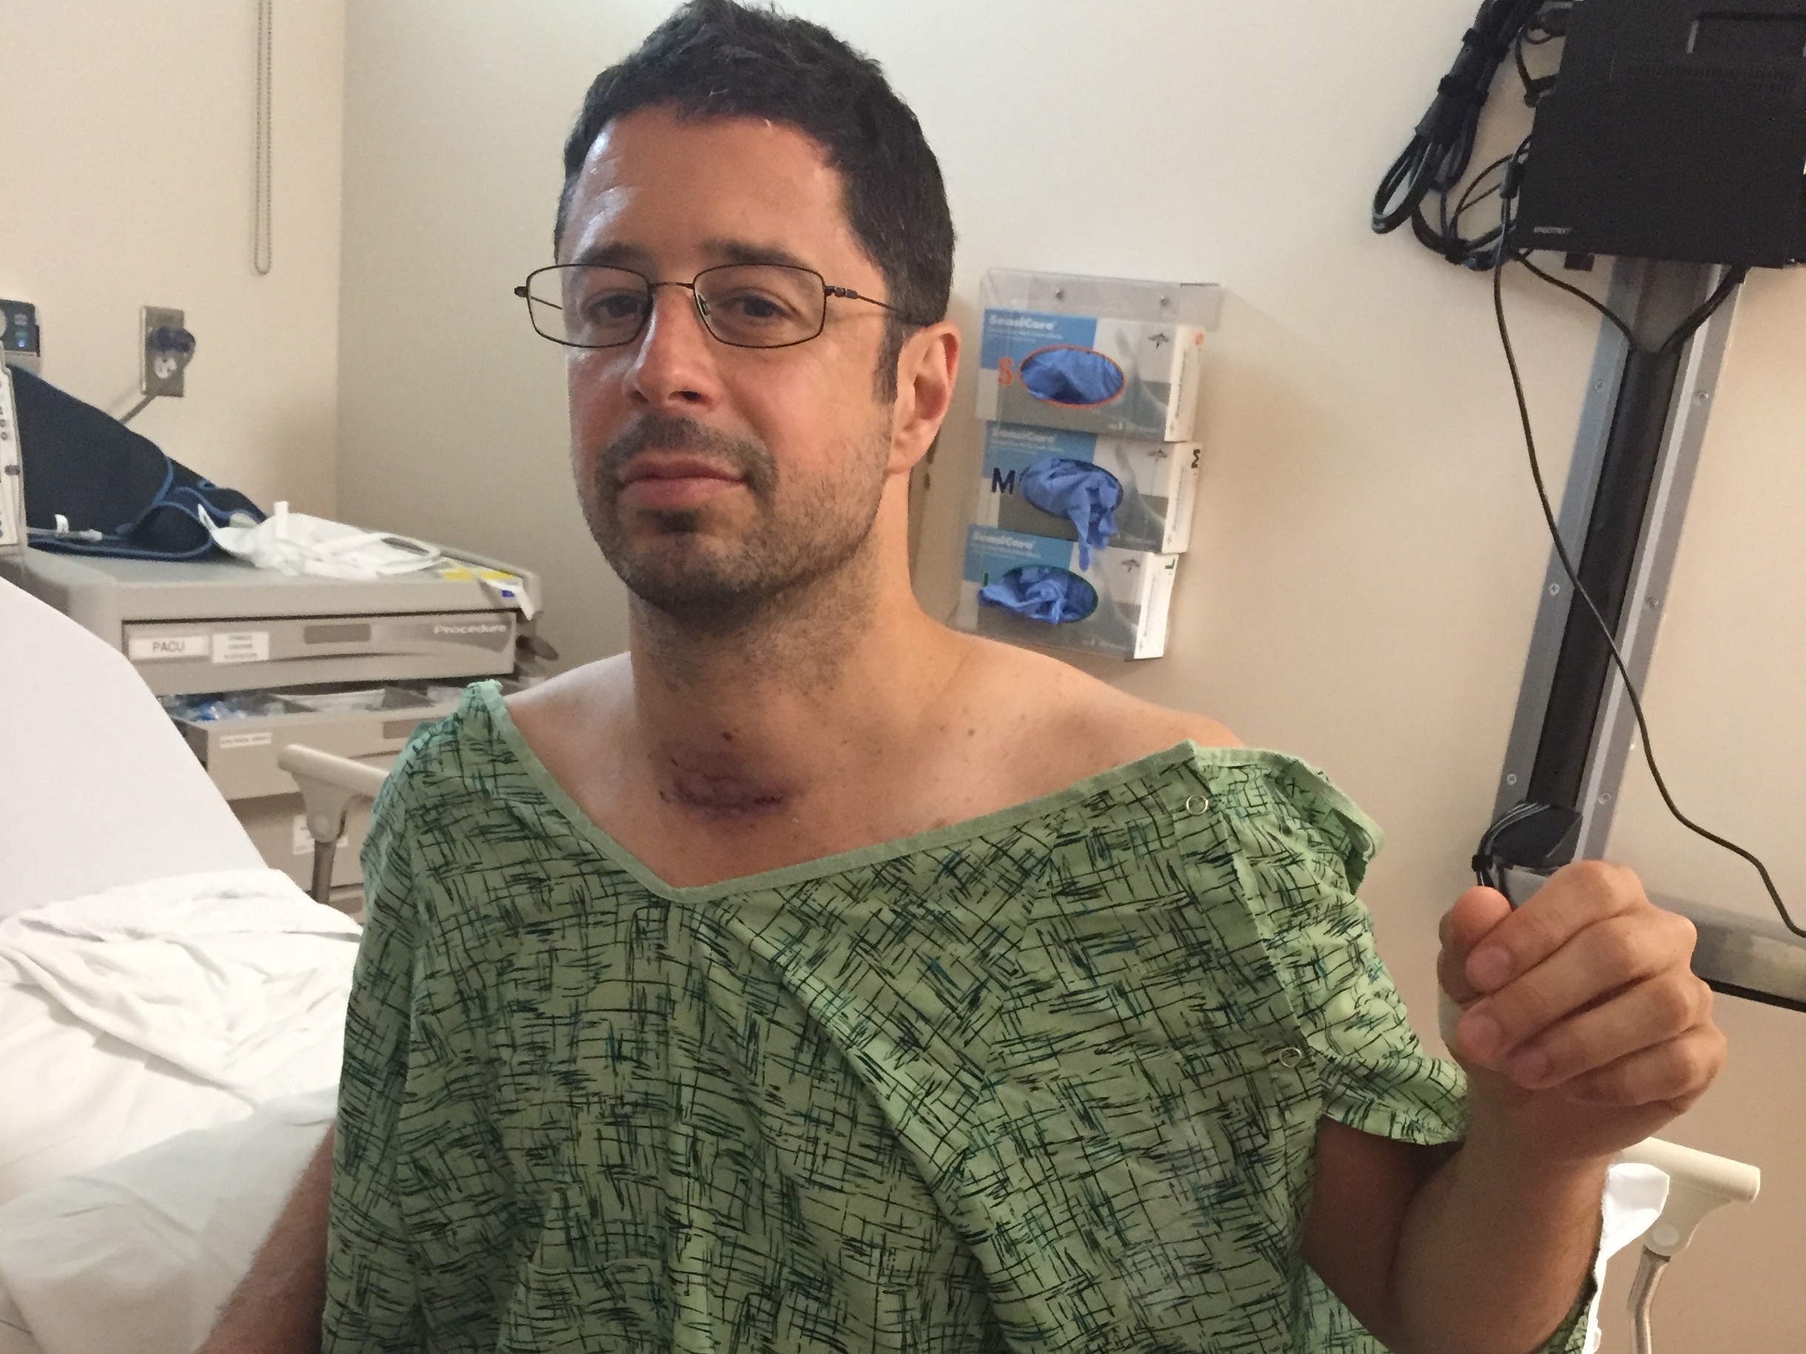
SEPTEMBER 2015

Slide 20
Current Challenges

Slide 21
Current Challenges
Overwhelm

Slide 22
Current Challenges
Overwhelm
Scarcity

Slide 23
Current Challenges
Overwhelm
Scarcity
Structure

Slide 24
Fear is the path to the dark side…fear leads to anger...anger leads to hate...hate leads to suffering

Slide 25
1) TRUST THAT EVERYTHING IS AN OPPORTUNITY FOR LEARNING AND GROWTH

Slide 26
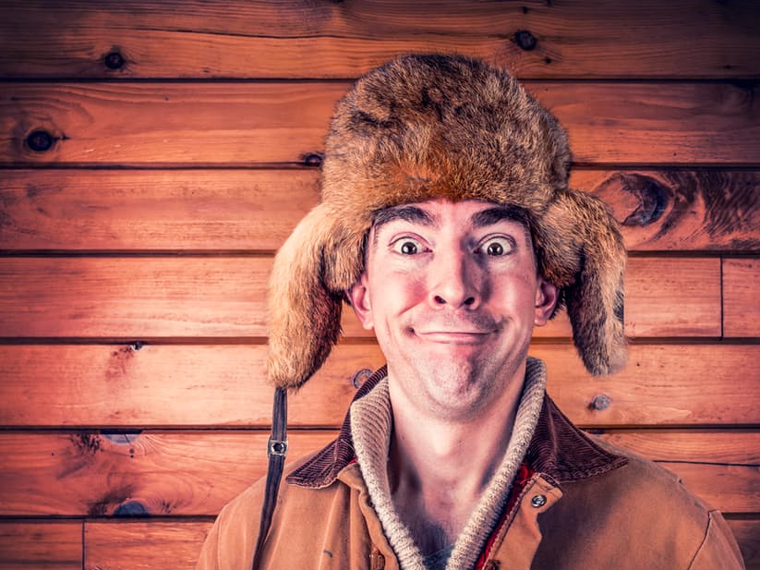
2) COMMIT TO BEING PERSONALLY RESPONSIBLE FOR YOUR EMOTIONS

Slide 27
3) LISTEN WITHOUT AN AGENDA

Slide 28
4) OBSERVE FROM A PLACE OF NEUTRALITY

Slide 29
5) ASK POWERFUL QUESTIONS

Slide 30
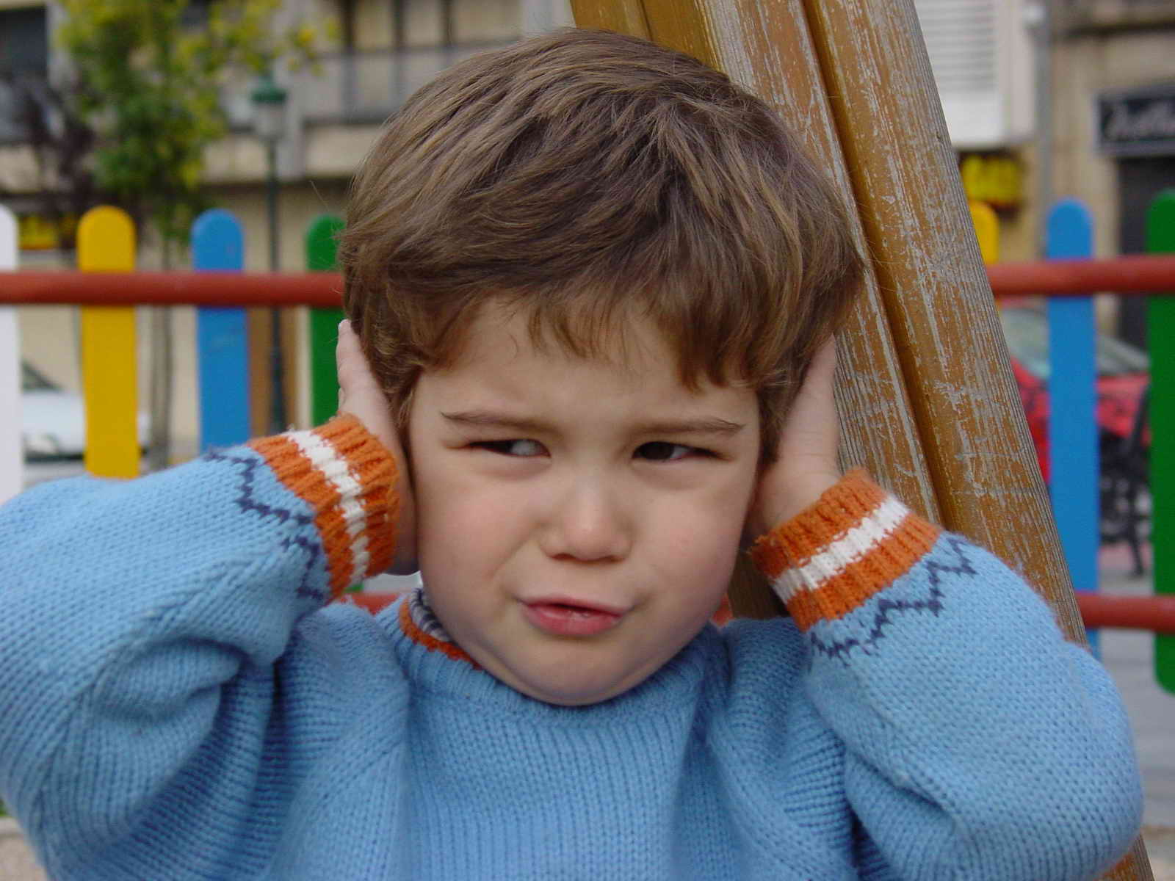
LOTS OF NOISE THESE DAYS

Slide 32
EMAIL

Slide 33
FAMILY
EMAIL

Slide 34
FAMILY
EMAIL
PARTNER

Slide 35
FAMILY
EMAIL
POLITICS
PARTNER

Slide 36
FAMILY
EMAIL
POLITICS
PARTNER
FACEBOOK

Slide 37
FAMILY
EMAIL
POLITICS
PARTNER
TRAUMA
FACEBOOK

Slide 38
FAMILY
EMAIL
POLITICS
PARTNER
TRAUMA
FACEBOOK
WORK

Slide 39
INSECURE
FAMILY
EMAIL
POLITICS
PARTNER
TRAUMA
FACEBOOK
WORK

Slide 40
INSECURE
FAMILY
EMAIL
POLITICS
PARTNER
TRAUMA
FACEBOOK
EVENTS
WORK

Slide 41
INSECURE
FAMILY
EMAIL
POLITICS
PARTNER
TRAUMA
FACEBOOK
EVENTS
WORK
EGO

Slide 42
INSECURE
FAMILY
EMAIL
POLITICS
SICK
PARTNER
TRAUMA
FACEBOOK
EVENTS
WORK
EGO

Slide 43
INSECURE
FAMILY
EMAIL
POLITICS
SICK
PARTNER
SELFISH
TRAUMA
FACEBOOK
EVENTS
WORK
EGO

Slide 44
INSECURE
FAMILY
EMAIL
POLITICS
SICK
DISTRACTIONS
PARTNER
SELFISH
TRAUMA
FACEBOOK
EVENTS
WORK
EGO

Slide 45
3 LEVELS OF LISTENING

Slide 46
LEVEL
1

Slide 47
“The message sent is not always the message received”
- Virginia Satir

Slide 48
WHAT ABOUT ME?!
1

Slide 49
WHAT ABOUT ME?!
TRAUMA

Slide 50
INSECURE
WHAT ABOUT ME?!
TRAUMA

Slide 51
INSECURE
WHAT ABOUT ME?!
TRAUMA
EGO

Slide 52
INSECURE
WHAT ABOUT ME?!
SELFISH
TRAUMA
EGO

Slide 53
HOW DOES THIS RELATE TO SALES?

Slide 54
Anticipate what’s next
LEVEL 1

Slide 55
Anticipate what’s next
LEVEL 1
I know what you need

Slide 56
Anticipate what’s next
LEVEL 1
I know what you need
Totally…..me too!

Slide 57
Anticipate what’s next
LEVEL 1
I know what you need
Totally…..me too!
Gotta be somewhere

Slide 58
Anticipate what’s next
LEVEL 1
I know what you need
Totally…..me too!
Gotta be somewhere
What about the plan

Slide 59
When’s the last time you found yourself in the level 1 with a friend?
1

Slide 60
LEVEL
2

Slide 61
“Listening is a magnetic and strange thing, a creative force. When people really listen to each other in a quiet, fascinated attention, the creative fountain inside each of us begins to spring and cast up new thoughts and unexpected wisdom”
- Brenda Ueland

Slide 62
I HEAR YOU
2

Slide 63
I HEAR YOU
TRAUMA

Slide 64
INSECURE
I HEAR YOU

Slide 65
I HEAR YOU
EGO

Slide 66
I HEAR YOU
SELFISH

Slide 67
I HEAR YOU

Slide 68
Being Intentional
LEVEL 2

Slide 69
Being Intentional
LEVEL 2
Focus on other person

Slide 70
Being Intentional
LEVEL 2
Focus on other person
What mean for speaker

Slide 71
Being Intentional
LEVEL 2
Focus on other person
What mean for speaker
Being Present

Slide 72
Being Intentional
LEVEL 2
Focus on other person
What mean for speaker
Being Present
Perception Checking

Slide 73
Name one way on how being in the Level 2 will improve your days
2

Slide 74
LEVEL
3

Slide 75
“Listen and attend with the ear of your heart”
- Saint Benedict

Slide 76
I FEEL YOU
3

Slide 77
I FEEL YOU

Slide 78
I FEEL YOU

Slide 79
I FEEL YOU

Slide 80
I FEEL YOU

Slide 81
Intuition
LEVEL 3

Slide 82
Intuition
LEVEL 3
Below Waterline

Slide 83
Intuition
LEVEL 3
Below Waterline
Feeling Emotions

Slide 84
Intuition
LEVEL 3
Below Waterline
Feeling Emotions
Connecting Deeper

Slide 85
Intuition
LEVEL 3
Below Waterline
Feeling Emotions
Connecting Deeper
Underlying Meaning

Slide 86
3
Name a time at school when you listened in Level 3 and how it benefited you

Slide 87
1 WHAT ABOUT ME?!

Slide 88
1 WHAT ABOUT ME?!
2 I HEAR YOU

Slide 89
1 WHAT ABOUT ME?!
2 I HEAR YOU
3 I FEEL YOU

Slide 90
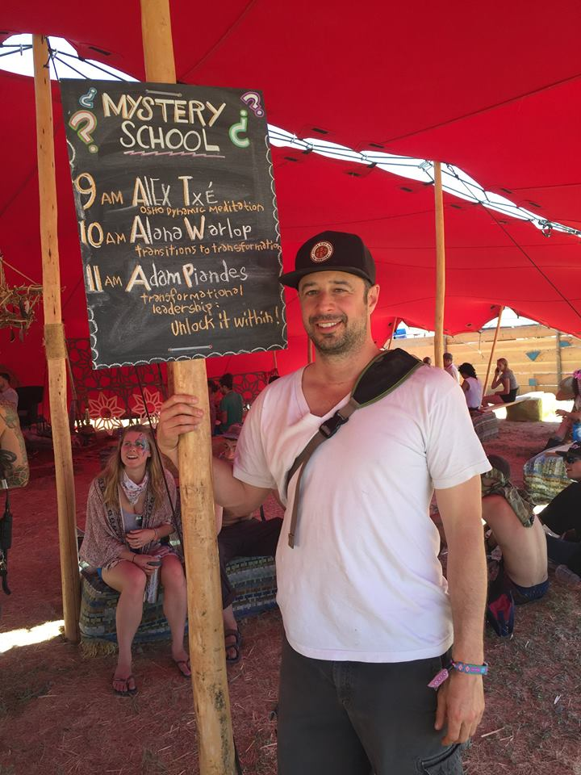
Contact
adam@adampiandes.com

