Slide 1
YBA GUEST
SPEAKER:
HEATHER
Lindsey

Slide 2
INTRODUCTION
My name is Heather Lindsey and I am 40 years old.
I work for CHECKLIGHT HOME SERVICES
CHECKLIGHT offers preventative, proactive maintenance for your home.
My role at CHECKLIGHT is PRESIDENT/PARTNER and my job is to do whatever is not being done; and, to offer support.

Slide 3
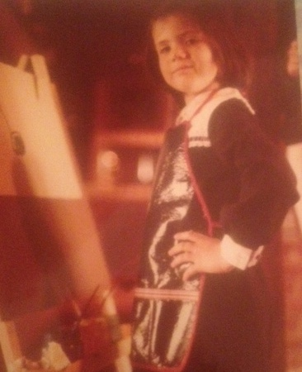
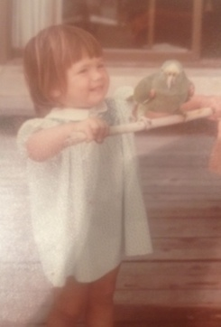
The Early Years…
I was born in Oakland, CA and raised in San Diego, CA
Age 6
e.
Age 1 ½
e.

Slide 4
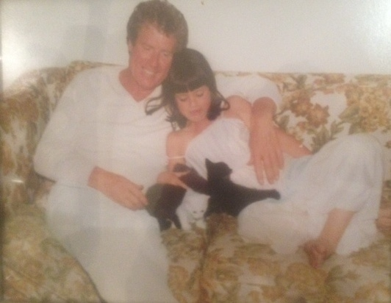
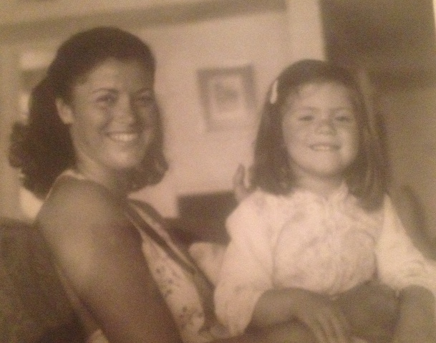
More Early Years…
A little about my family…
These are pictures of me & my parents.
I love being an only child.

Slide 5
HIGH SCHOOL
I attended The Bishops School in La Jolla, CA.
I failed Latin because I could see the ocean from the classroom.
Insert map shot here

Slide 6
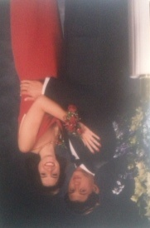
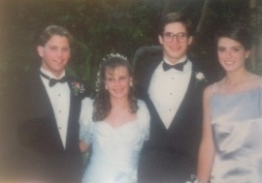
HIGH SCHOOL
As a HS student I was involved in a lot of studying. I was fortunate that my high school offered many activities.
As a HS student I was shy, nice, academic.
\
Here is a shot of me in HS
Me as a senior grade student

Slide 7
HIGH SCHOOL
Things I enjoyed in HS
Things I did not enjoy in HS
Friends
History & Political Science
Science
Photography
Economics
Drama
Latin
Calculus
Grammar

Slide 8
HIGH SCHOOL
Activities/Athletics in HS
Yearbook
Field hockey
Languages
Model UN
Track & field*
Student Counsel
AP Courses
Photography
Pottery
Piano
NCL/philanthropy volunteering

Slide 9
HIGH SCHOOL
Obstacles/Adversity you had to overcome in HS
Fondest memories from HS
Friends
Learning how to learn-aka solving the puzzle
Hanging Out
Figure out what tenants/pillars resonate with you now.
  What makes you who you are?
  You practice them in college.
  They will serve as your north stars through life. Both personally and professionally.
The hardest I worked was in high school.
  My study habits were formed there.
  How to learn. How to discipline myself. How to write papers/thesis.
  It was the hardest I worked mentally including HBS/HLS, but it made the rest easy (ish).

Slide 10
College
I attended UCLA. I was the first person in my immediate family to finish college.
Why UCLA? Good choice?
\

Slide 11
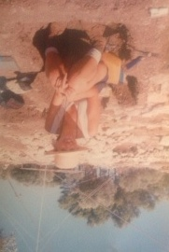
College
College
Activities/Athletics in College
Be involved. Socially, philanthropically, and with hobbies/interests. That reflects and makes you an interesting, well rounded person.
Why?
Interned at ABC News
Interned at environmental consulting company
Earthwatch archeology dig
Summer school in Paris
LACMA
Graduated early and worked at start-up until grad school

Slide 12
College
Favorite classes
Political Science
Strategy
Organizational Development/Management
Anthropology
Archeology
Near Eastern Studies
African Political Science

Slide 13
Graduate School
I attended Harvard Law School and Harvard Business School in Boston, MA.
\

Slide 14
Graduate School
Favorite classes/Fondest memories
Least favorite classes/memories
Constitutional Law
Lead
Marketing
Finance
Friends
Dances
Trips
Challenging myself
Learning skills (esp law school)
TOM-ugh
Torts (I still think they are just a pastry)
COLD!!!
Law School Attitude

Slide 15
Graduate School
Obstacles or adversity that you had to overcome
Self- Confidence
Shyness
Lack of experience
Only female in JD/MBA*
Learn to network. It is your friend.

Slide 16
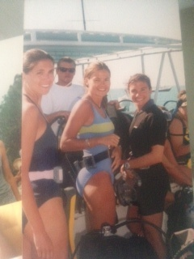
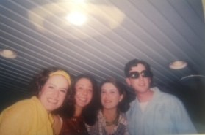
Graduate School
Grad School
Activities Grad School
Law School vs Business School
Environmental Law Review
Ent. & Media at HLS/HBS
Mentoring children
Real Estate Club
Interned at Getty Museum
Interned at commercial production company
Interned at Carsdirect.com

Slide 17
Jobs
CheckLight Home Services
Partner/President. Small, growing business.
Crowdfunder.com
COO. 5-20+ people
Dev-Land Inc./Consulting
VP. Family Business
Lucky Brand Jeans
Director
CarsDirect.com
ADForce/CMGI
Notes:
Use this graph to give more description of your current company (history, size, location, products and services, etc.)

Slide 18
Career Path
I started as an intern at an Internet company….
I went to a sub of a Fortune 100 company
I was COO at an Internet Company
Notes:
You may use this chart to describe your journey to the current career

Slide 19
Career Path LESSONS
Find a mentor or several. In college. In grad school. In your career.
Reach out to companies you want to work for.
Don’t wait for job opening. Most of my jobs were created for me. What is the worse thing that happens? They so no? Who cares?
Prove your value, then ask for an opportunity. Ask for help.
Notes:
You may use this chart to describe your journey to the current career

Slide 20
Career

Slide 21
Career
Some challenges I had to overcome in my career
Self-Confidence
Recognizing my skill
Verbalizing what I am good at
Lack of career path
Uncertainty
I wish I had gone to law firm/consulting firm/ bank for a year just to have the presentation skills.

Slide 22
Current Role
Partner
Legal
HR
Business Development
Trouble-Shooting
Finance
Operations
Notes:
Use this graph to give more description of your role specifically (responsibilities, typical work week, direct reports, etc.)

Slide 23
Entrepreneurship
Although most VCs would shirk if they heard this, its all a gamble.
It is fun. But the hardest you will work.
In managing people, be who you are.
You get to where a ton of hats.
There are many management styles, but if you are managing people and it comes across unauthentic, it will do you little good even if it’s the best style out there.
I mentored a gentleman, and he learned everything. In 2 years, he knew the basics of running a company. You don’t get that type of opportunity at a normal gig.
Chaos versus organization. Learn what you like.
Do what you know? Do what you love?
Notes:
Use this graph to give more description of your current company (history, size, location, products and services, etc.)

Slide 24
Career Compensation
Mixture of All
Fixed Salary
$200-$400K
Hourly Rate
$200-$800
Stock
Compensation:
What stage and how senior
Notes:
Use this graph to show general compensation ranges for people in various roles in your company

Slide 25
ACADEMIC EXERCISE
We will now spend several minutes discussing the day’s academic module and how it is relevant in the ‘real world’
But before we do………

Slide 26

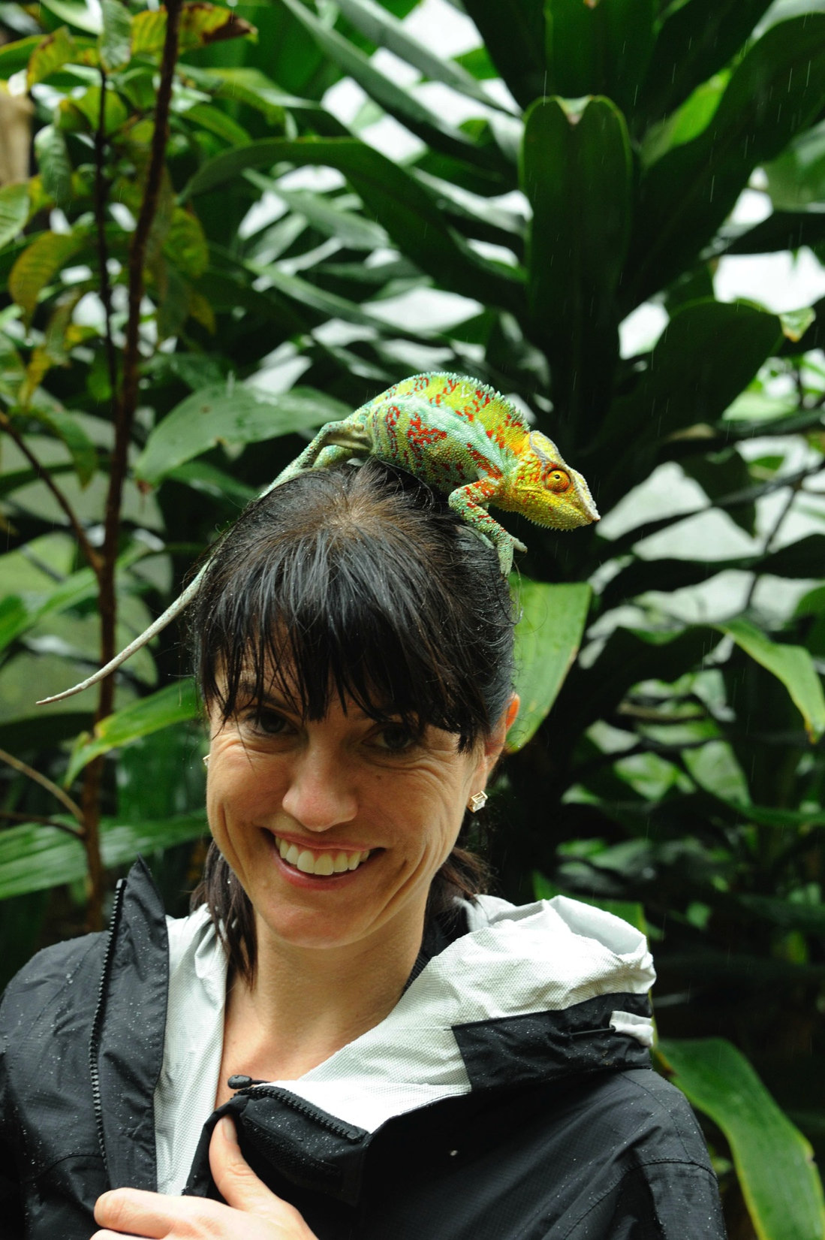
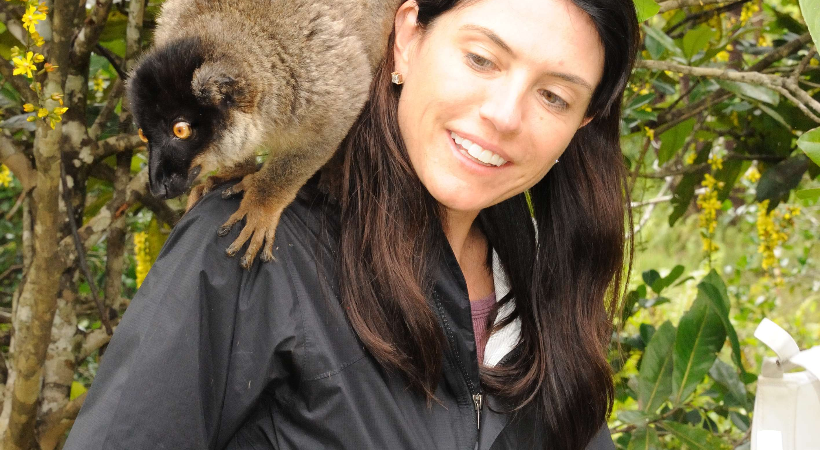
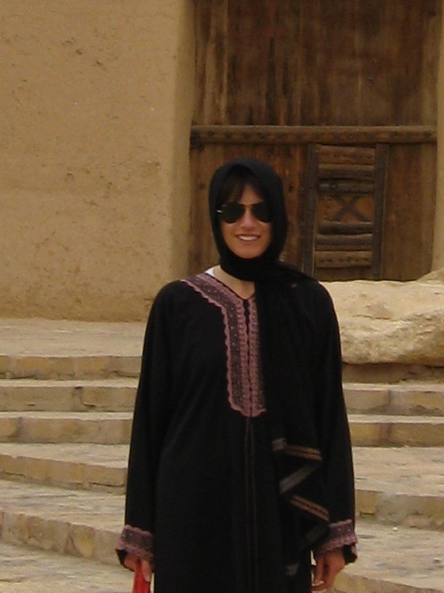
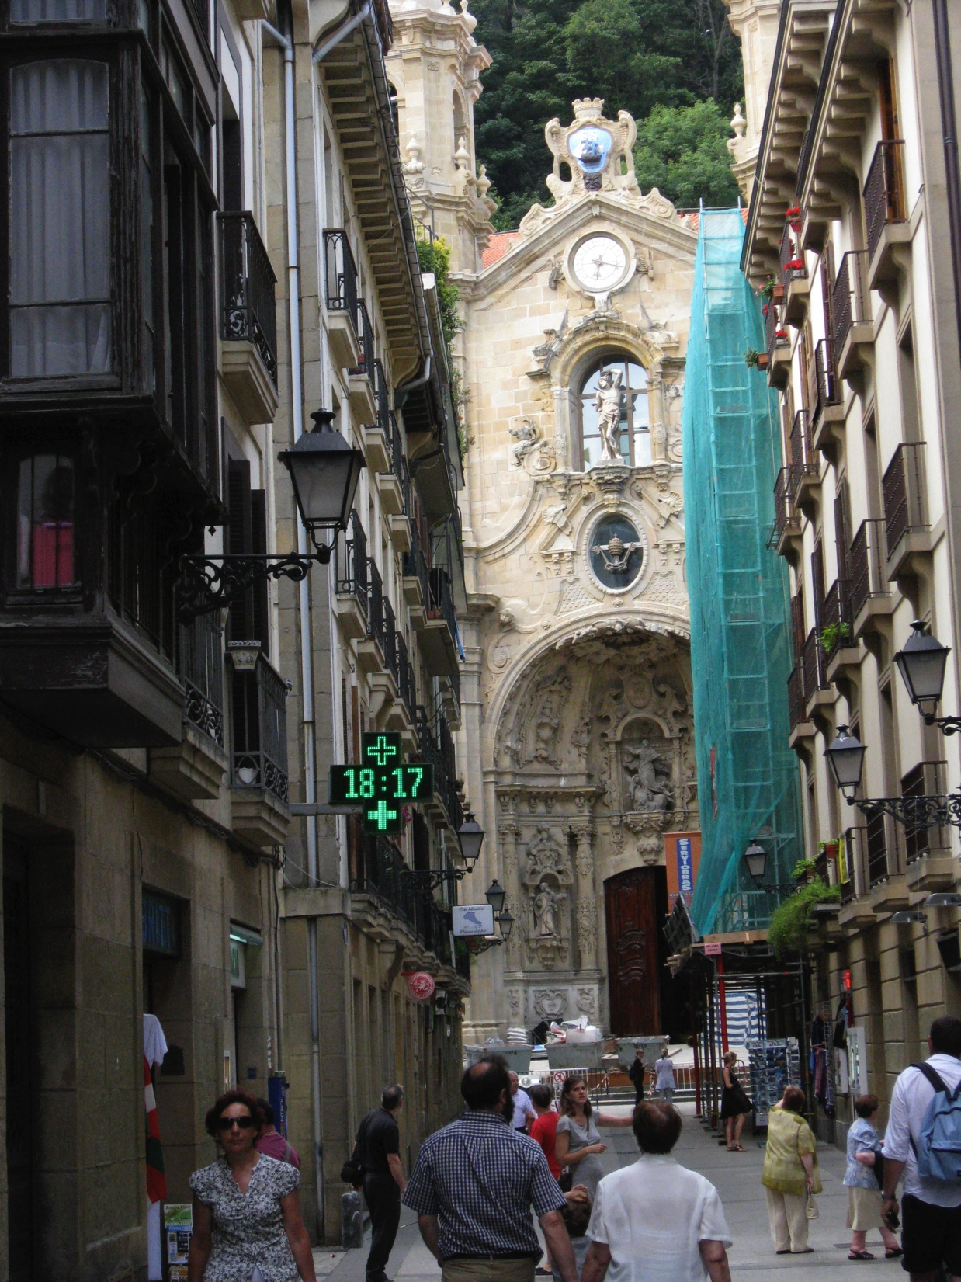
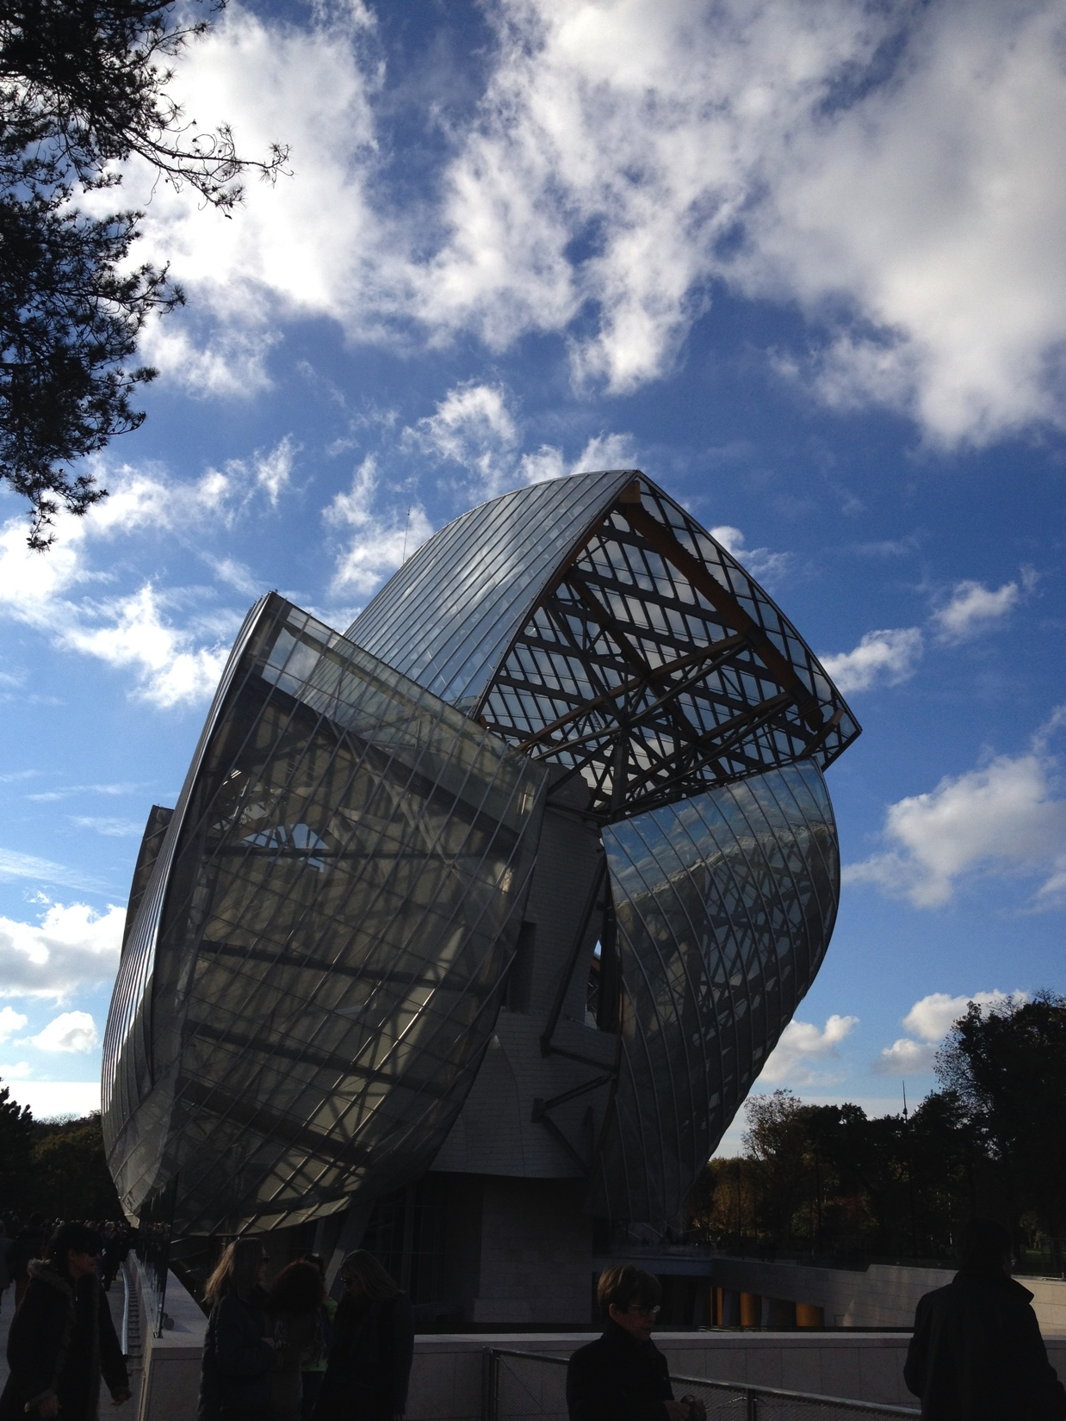
It is a big world…..

Slide 27
Things I have learned
Be happy and remember most of it we take too seriously.
There are many roads. None are right or wrong. Don’t let choosing the right decision freeze you.
Don’t worry about what other people do.
Being the only woman in groups/jobs is awesome. Don’t be afraid of it. Don’t overthink it.
If you find yourself without a path. Without a job. Without whatever you think you are supposed to have, don’t panic. Accept it, be okay with it, ignore the naysaying in your head, and move forward.

Slide 28
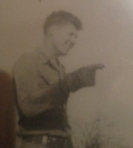
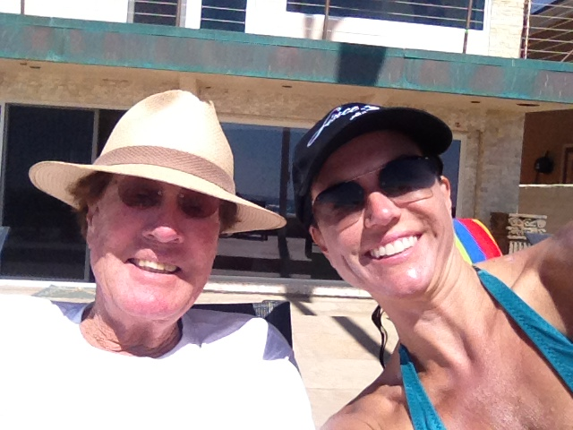
You create your future
My dad’s story: you can create you own destiny if you overcome obstacles, see opportunity and seize it.
You just need to set your mind to it.

Slide 29
ACADEMIC EXERCISE
We will now spend several minutes discussing the day’s academic module and how it is relevant in the ‘real world’

Slide 30

QUESTION AND ANSWER

