Slide 1
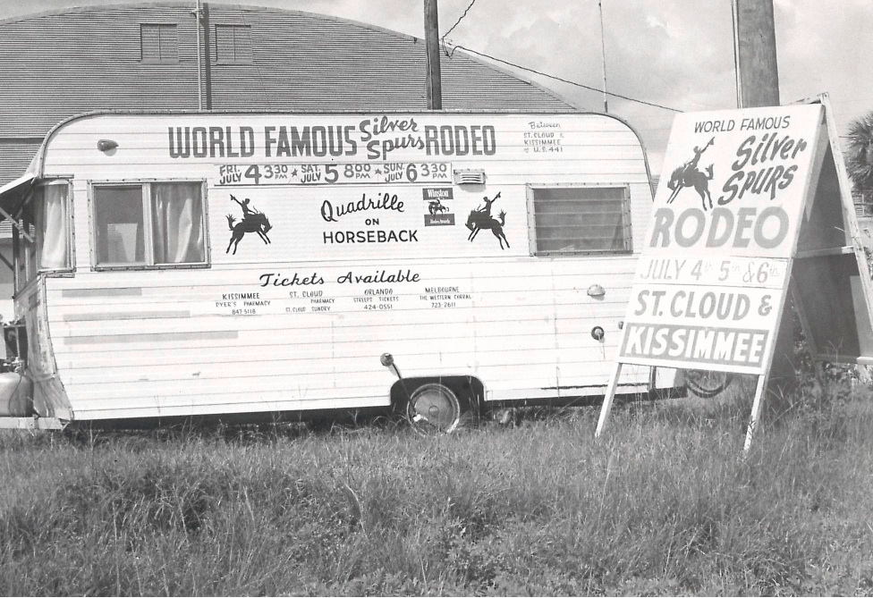
Kickers Korner in Central Texas.
Business is fun, rewarding and not what it seems.

Slide 2
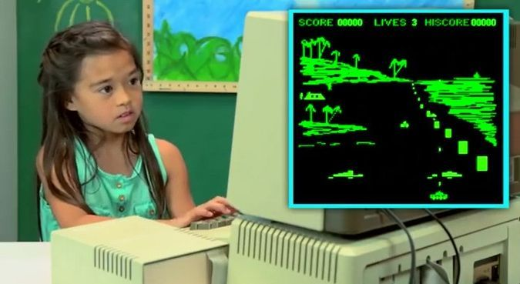
Digital came to life.

Slide 3
College and Early Career

Slide 4
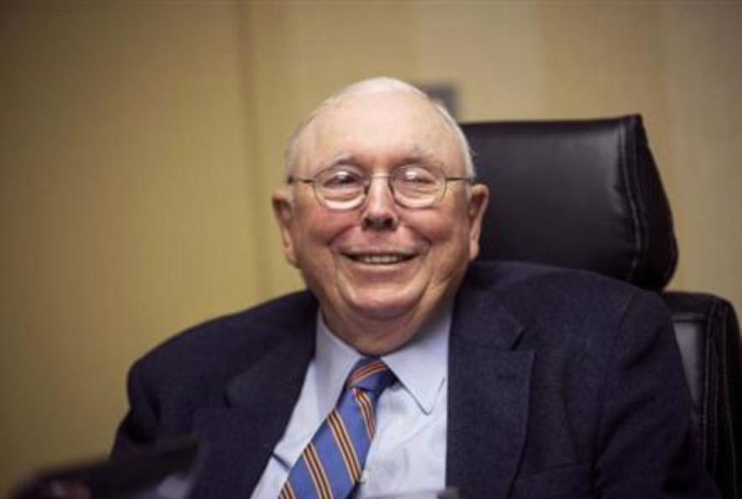
Best Early Advice
How to be successful by Charles Munger:
There’s a lot that will happen that is different for everyone. But there are 2 things that I can tell two you will absolutely have to do:
spend less than you make
be reliable

Slide 5
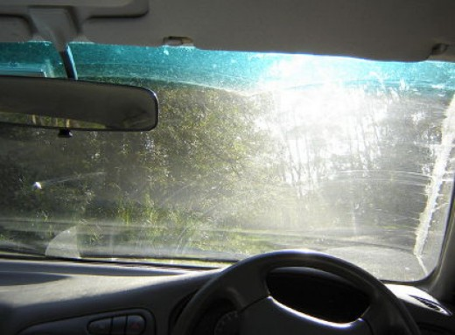
Complexity is everywhere. Keep it simple.

Slide 6
Day In the Life of Growth Marketing
Think | Try
Track | Turn

Slide 7
What You Can Do Now
Get involved with groups
Hone in on your strengths
Start saving: time and money

