Slide 1
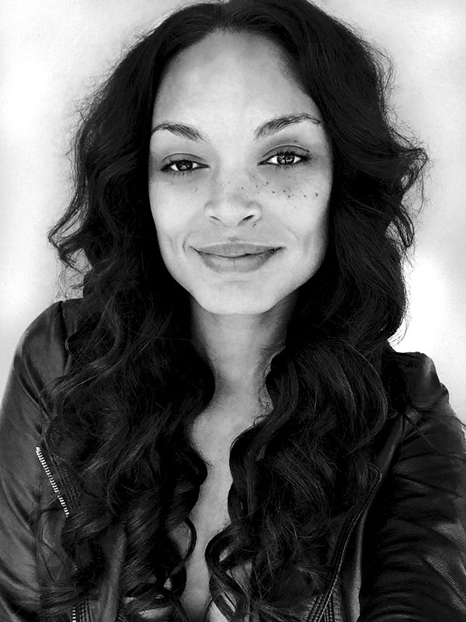
SHANNON ADAWN

Slide 2
Introduction
I am 32 years old and originally from Washington, DC
I work as an Actor and Multi-Media Artist at Who Shot Ya
My company specializes in Photography, Graphic Design, and Brand Development
My photographic services include Portraits, Special Events, Lifestyle, Fashion, Beauty, Music, and Film
My graphic services include Logo Development, Product Design, Publication, and Websites
My clientele base includes Actors, Artists, Models, Designers, Producers, Filmmakers, and Entrepreneurs

Slide 3
Benefits of my career
The journey of inspiration
Exploring the creative process
The freedom of living as a creative
Establishing relationships with clients
Serving as an influence in pop culture
⬥ The fulfillment of getting paid to do what you love

Slide 4
Challenges of my career
⬥ The process of negotiation
Navigating the murky waters of pro bono work
The need for discipline and time management
The difficulty of having to translate your client’s ideas
The expense of maintaining current equipment and software
The pressure to stay relevant in a competitive freelance artists market

Slide 5
Requirements for Taking a New Path
The courage to start all over
Recognize the skill set you have acquired for new opportunities
Utilize your support system
Commit to learning what you need to know
Believe that you can succeed
HAVE FUN

Slide 6
Purpose and Power
workshop

Slide 7
synopsis
This workshop will teach you the cultural significance of Purpose and Power and how to
cultivate them in your daily life.
The life skills you will gain from this workshop are the following…
Develop a keen understanding of Purpose and Power
Enhance your level of self awareness
Improve your interpersonal skills
Increase your self-confidence
Learn to define your personal value system for life

Slide 8
What is power?

Slide 9
Webster’s definition
ability to act or produce an effect
possession of control, authority, or influence over others
physical might
an order of angels
a source or means of supplying energy

Slide 10
Biblical reference
For God hath not given us the spirit of fear; but of power, and of love,
and of a sound mind.
-2 Timothy 1:7

Slide 11
Mainstream Examples
Money
Popularity
Material objects
Physical Beauty

Slide 12
Alternative examples
Creating connection with others
Effective communication
Knowledge of self and one’s morals
The bold pursuit of purpose
Being a source of inspiration

Slide 13
Who empowers you?

Slide 14
What is purpose?

Slide 15
Webster’s Definition
the reason why something is done or used
the feeling of being determined to do or achieve something
the aim or goal of a person
what a person is trying to do, become, etc.

Slide 16
The fundamentals of purpose
Loving who you are
Loving what you do
Keeping good company
Giving back to the world

Slide 17
What do you love about yourself?

Slide 18
Benefits of self love
High self-esteem
Owning your power
Freedom of expression
Ask for what you want
Cultivate healthy relationships

Slide 19
What are you passionate about?

Slide 20
Benefits of knowing your passion
The joy of fulfillment
Freedom to be yourself
Increased energy
Willingness to take risks
Having a community of supporters

Slide 21
What is a true friend?

Slide 22
Benefits of true friendship
The joy of fellowship
Freedom to be transparent
Accountability that builds character
Genuine support that is consistent
A community to celebrate your success with

Slide 23
How will you change the world?

Slide 24
Benefits of contribution
⬥ Paying it forward
The power of leadership
Connection to a global community
Being a source of inspiration
Reaping the harvest of being a servant

Slide 25
Thank you
Portfolio: www.whoshotya.me
IG: @Shannon_Adawn

