Slide 1





Sharing Your Brand
With Employers
Animo Pat Brown Charter High School
Youth Business Alliance Presentation
Ron Roberts, Jr., Recruiter, Griffith Company

Slide 2



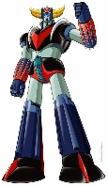

Who Is Ron Roberts, Jr.?
Corporate Recruiter & Diversity Specialist
  Griffith Company, Ernst & Young, Union Bank, RSM, etc.
Former College Career Advisor
  University of Southern California
Career & College Planning Partner
  High School & College Students, and organizations that support them.
A Big Fan Of:
  Philly Sports Teams, Superheroes, Native American Art, Inspirational Quotations, Chinese Food, Greeting Cards, Old School Anime, Professional Wrestling, Career/Job Fit, The Color Green, The Number 4, Sports Uniform Designs, Motivated Young People, My Wife and a few other things.

Slide 3
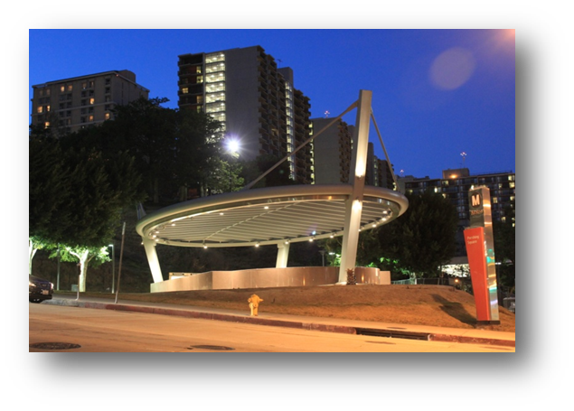




Who Is Griffith Company?
One of California’s earliest general contractors – established in 1902.
Builders engaged in a variety of heavy civil construction work in transportation, infrastructure (e.g. roads, bridges, dams) and site development.
Full service contractor to private and public sector clients such as: City of L.A., Port of Long Beach, LAX, NBCUniversal, Caltrans, Walmart and Kern County.
100% Employee Owned.
Offices: Bakersfield, Brea and Santa Fe Springs.
Provider of internships for college students.

Slide 4




Careers In Construction
(so much more than just ditch digging)
Industry to explore if you like or are good at:
  Building, designing or planning
  Managing projects or people
  Calculating, problem solving,
  communicating or selling
Growing industry with a high need for workers who are either young, female and or minority.
Plenty of job opportunities in the office and not just out in the field.
Sample Jobs That Require A College Degree: Project Engineer, Estimator, Project Accountant, Safety Director, Business Development Manager, Project Manager

Slide 5



A High School Memory
Falling On My Face

Slide 6
Be A Star At Who You Are!
Christina Aguilera
Blake Griffin
Serena Williams
Bruno Mars
Zoe Saldana
Jeremy Lin
Beyonce
Jimmy Fallon
Katy Perry
The Rock
Rihanna
Mario Lopez
Mindy Kalen
Drake
Taylor Swift
Kevin Hart
Selena Gomez
Justin Timberlake
Alicia Keyes
Pharrell
YOU
“The only person you are destined to become is the person you decide to be.” Ralph Waldo Emerson
“Your time is limited, so don’t waste it living someone else’s life.” Steve Jobs

Slide 7

A Question For You
What Is Your Value Proposition?

Slide 8















Let’s Talk About Brands
Definition Of A Brand: “a kind or variety of something distinguished by some distinctive characteristic.”

Slide 9
Another Question For You
What Qualities Are Employers Looking For In Potential Employees?

Slide 10

Getting In The Know
From Those Who Know
Informational Interviews

Slide 11
Reminders
Be A Star At Who You Are!
Know Your Value Proposition.
Learn How To Share Your Brand.
Get In The Know From Those Who Know.

Slide 12

Questions
Ron Roberts, Jr., Recruiter, Griffith Company

