Slide 1
Shawn Herrera, MBA CheerForce, CEO Pepperdine University, Adjunct Professor
“My Path….”

Slide 3
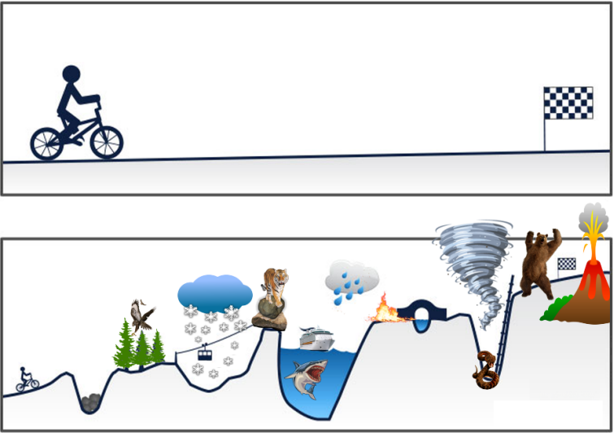
Your Plans

Slide 4
Your Plans

Slide 5
Your Plans
Reality

Slide 6
Your Plans
Reality

Slide 7
Video 6

Slide 8
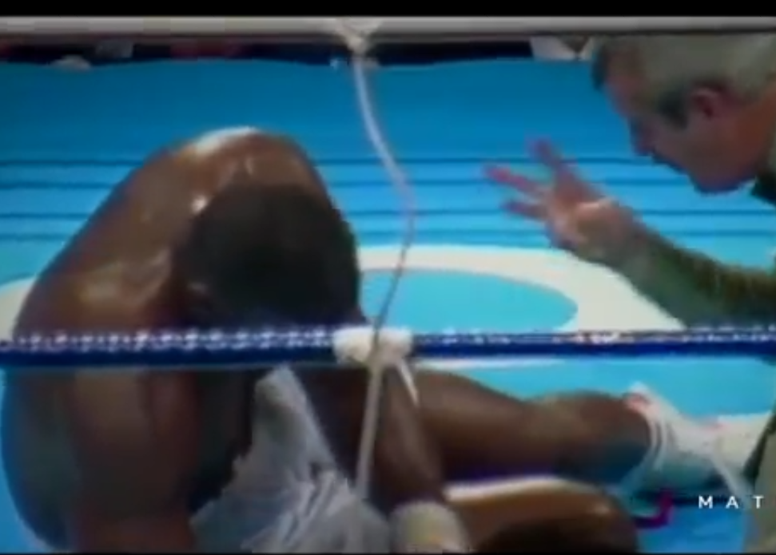
Having a strong “why”…
is what gets your back up ↑
after each time you get knocked down ↓

Slide 9
My Educational Path
1988-92: Quartz Hill High School [H.S. Diploma]
1992-94: Antelope Valley College [A.A. - Computer Science]
1994-96: University of Southern California [B.S. - Business]
2013-14: Pepperdine University [M.B.A. - Business]

Slide 11
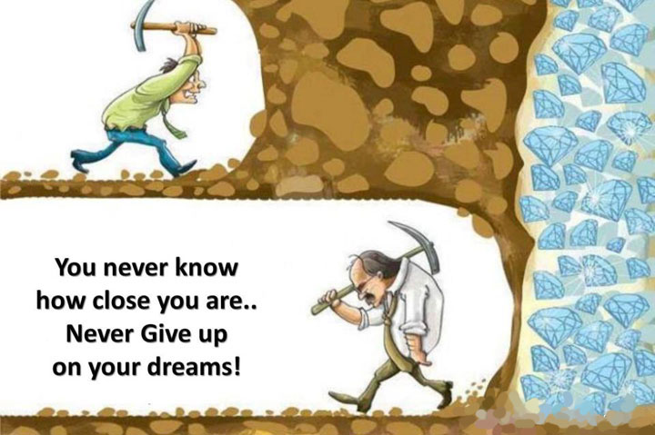

Slide 12
My Work Path (age 16 – 21yr)
In High School: Baskin Robbins → Marie Calendar’s → Subway
In College: Western Map Company → Farmers Insurance
WeMaCo

Slide 13
My Career Path
1995-2002: Pegasus Technologies, Founder
2002-Present: CheerForce, CEO
2016-Present: Pepperdine University, Adjunct Professor
ROAD Financial, Co-Founder

Slide 14
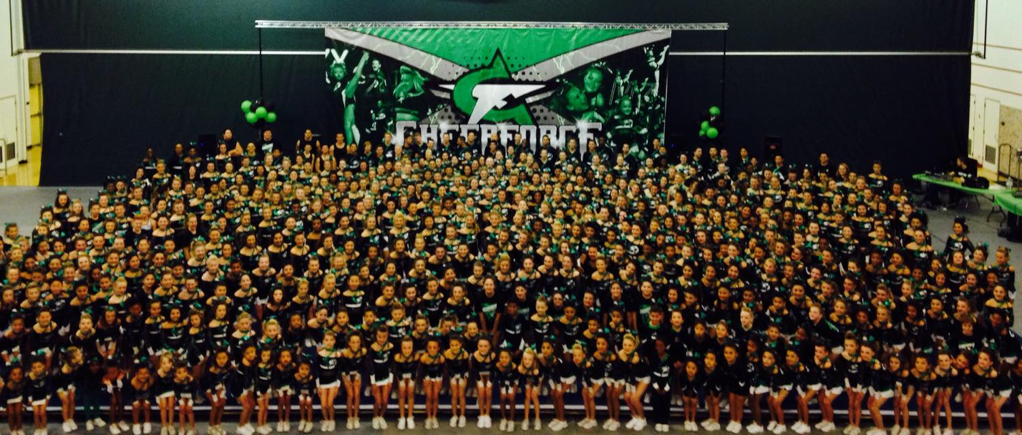
My Career Path

Slide 15
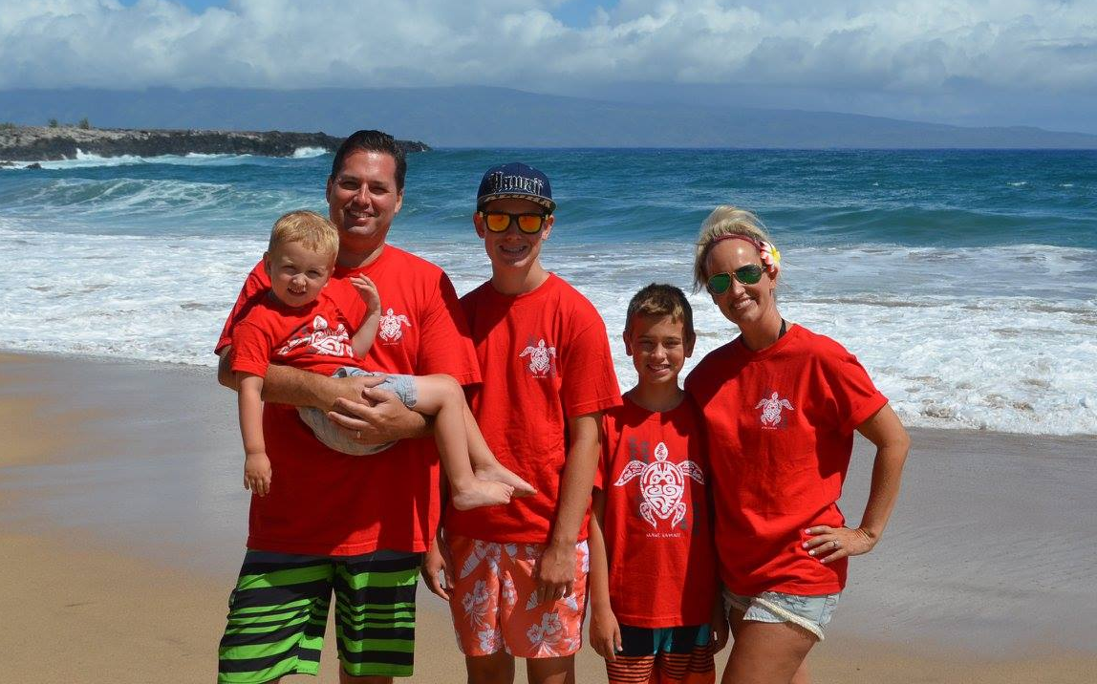
My Family

Slide 16
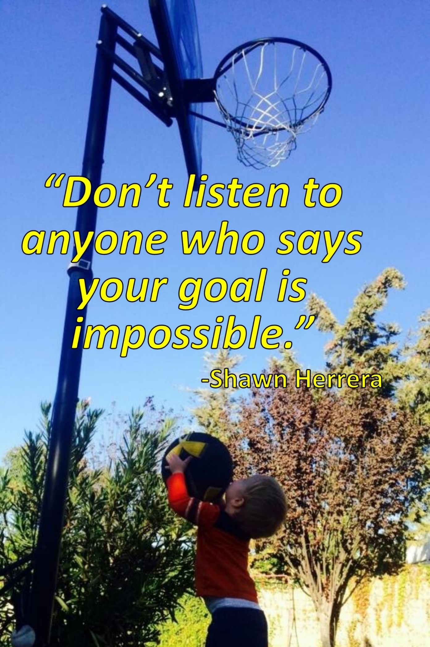

Slide 17
What is your “Why”?
I will < insert your “short-term” goal > , because this will help me < insert your “long-term” goal > .
When things get difficult & I feel like quitting, I will remember < insert your “why” > to help keep me motivated to continue. I deserve this.

Slide 18
Shawn Herrera, MBA CheerForce, CEO Pepperdine University, Adjunct Professor
“My Path….”

