Slide 1
Michael Leventhal

Slide 2
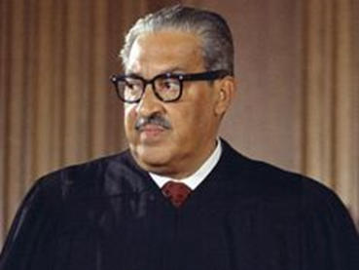

Slide 5
GOTTA CATCH ‘EM ALL!

Slide 6
Handheld AR
https://www.youtube.com/watch?v=oH_LfXnklRw

Slide 7
Headmounted AR
https://www.youtube.com/watch?v=kPMHcanq0xM

Slide 8
LOTS OF DIFFERENT TYPES OF LAWYERS

Slide 9
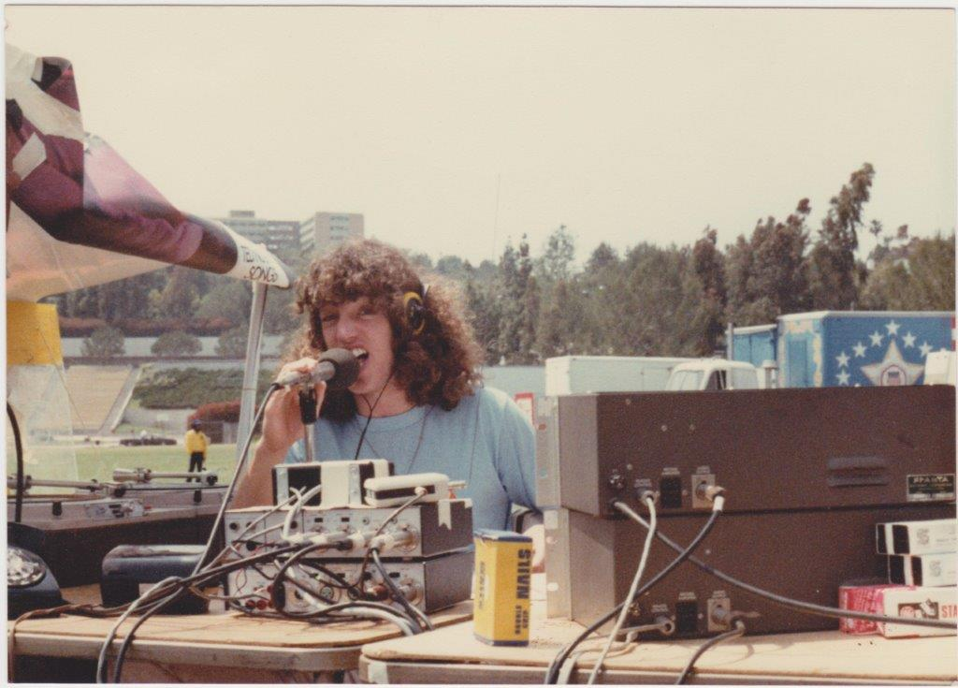
MY PATH

