Slide 1
Tamara Siegel

Slide 2

INTRODUCTION
Hi, I am Tamara Siegel and I am 45 years old.
I work for
Quiksilver produces boardshorts and other clothing items for the action sports market under Quiksilver, DC Shoes and Roxy brands.
I am the Director of Licensing at Quiksilver. We have recently started to partner with experts in categories like watches, backpacks and beach towels to produce our products.

Slide 3

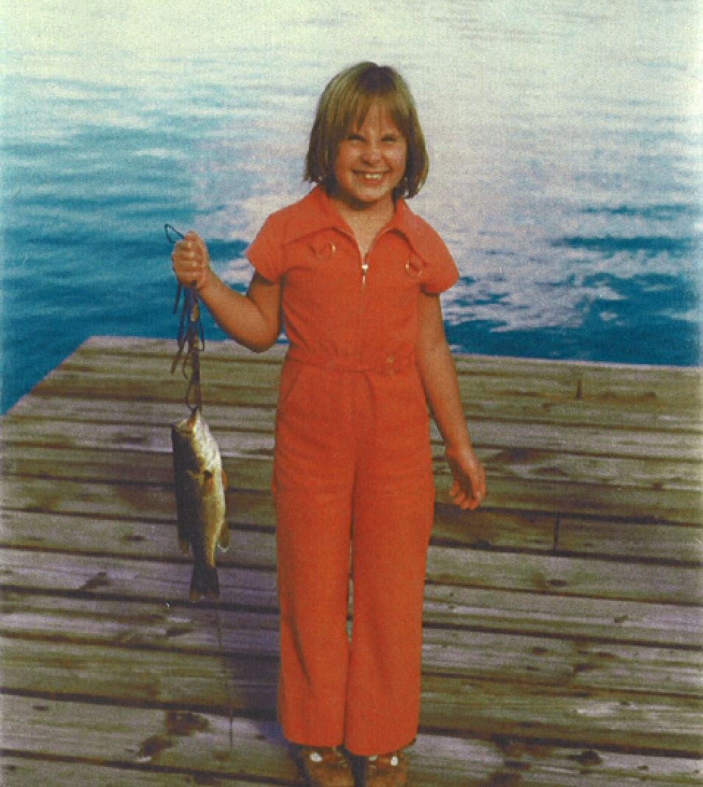
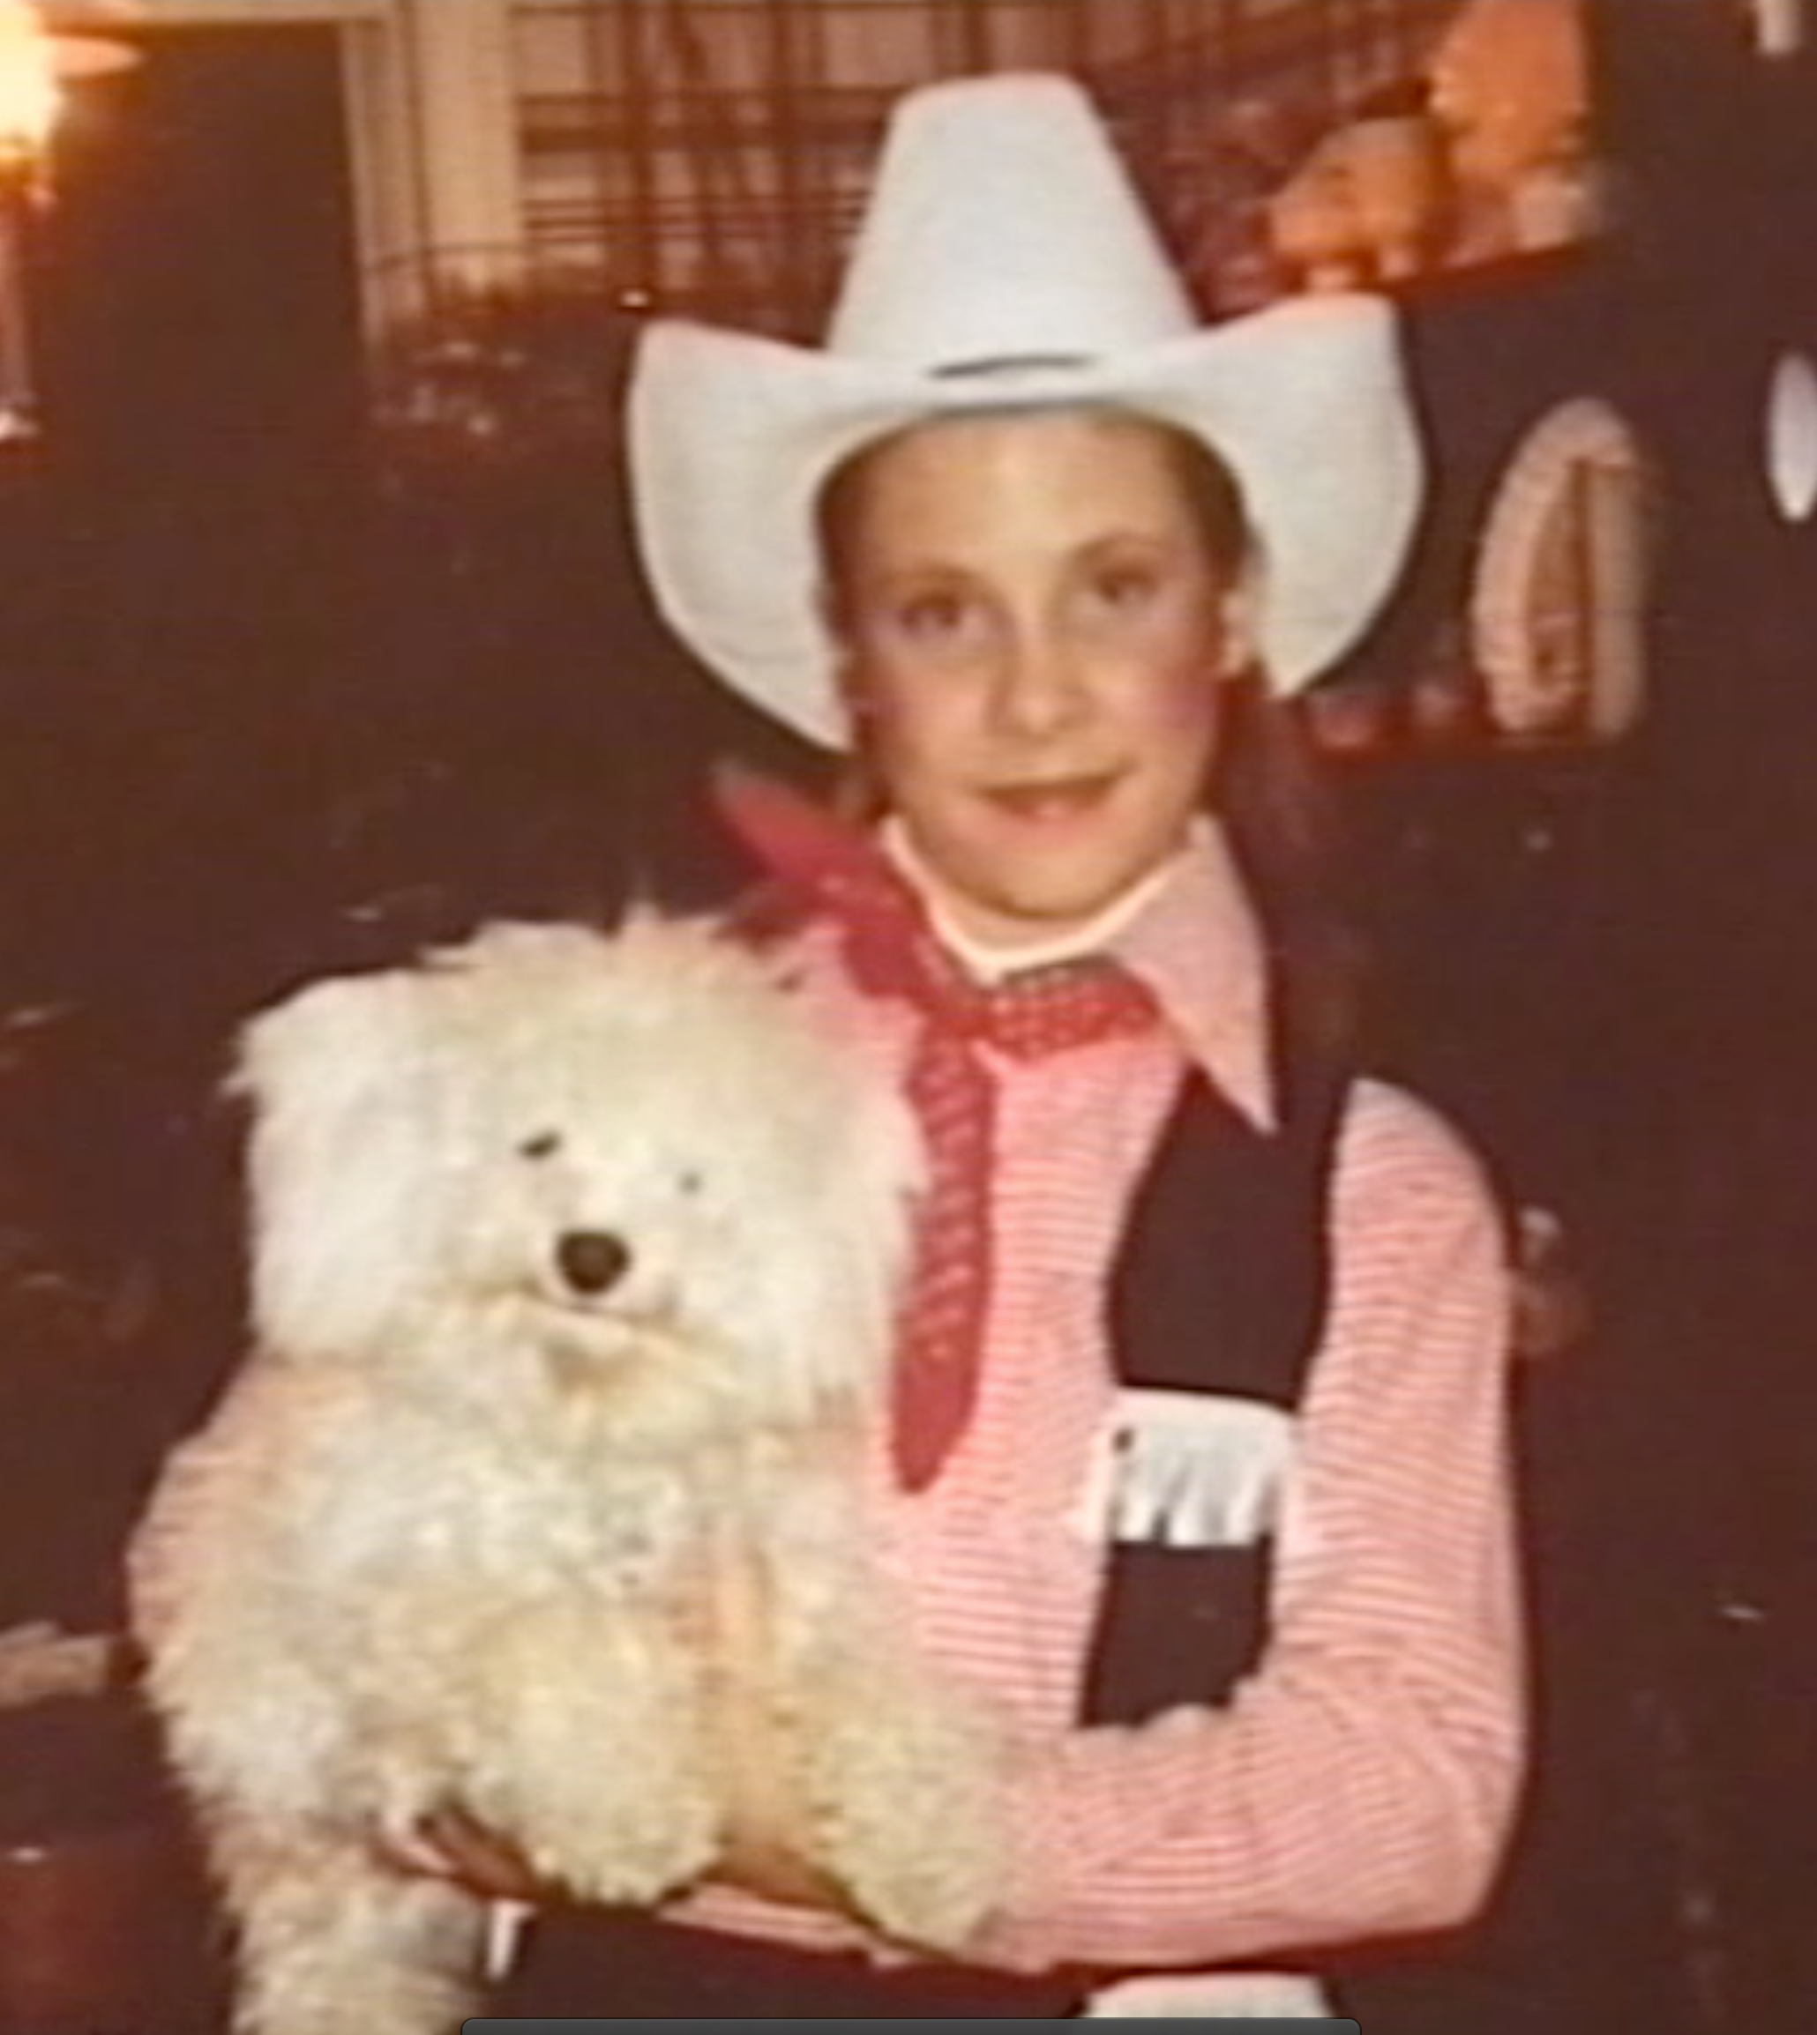
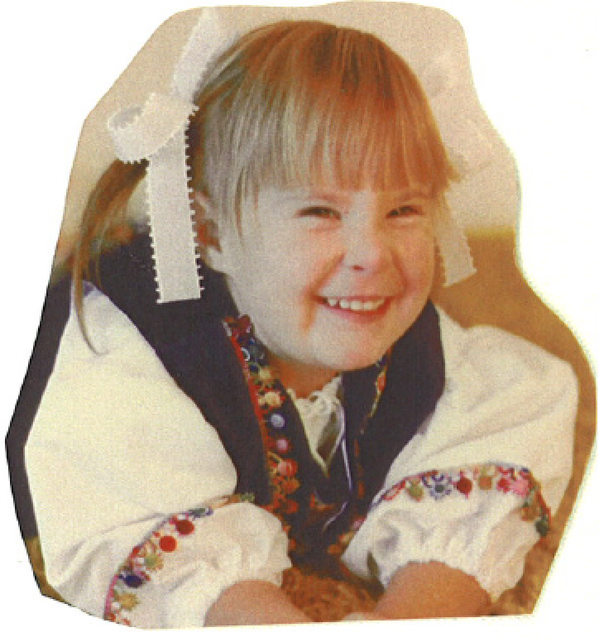
The Early Years…
I was born and raised in Toronto Canada and grew up in a small town in Alberta.
This is a picture of me at age 2.
This is a picture of me at age 7.
This is a picture of me at age 11.

Slide 4
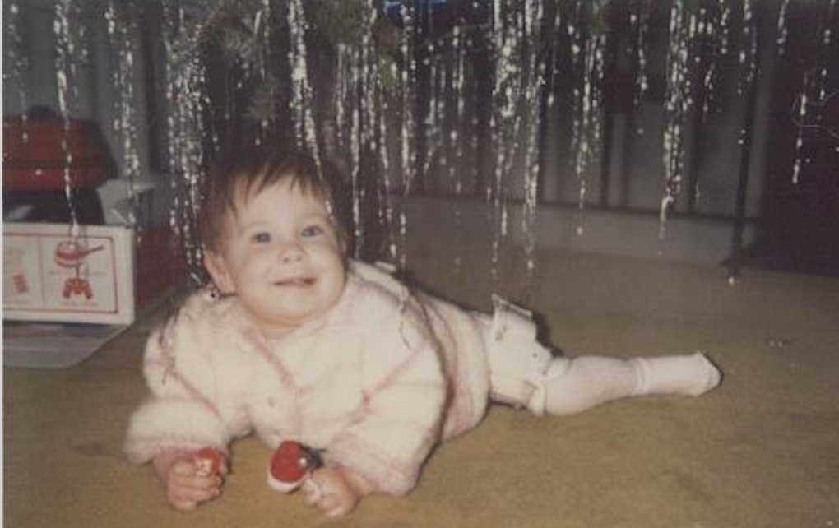
The Early Years…
I was born without a hip socket and had several operations in order to walk…

Slide 5
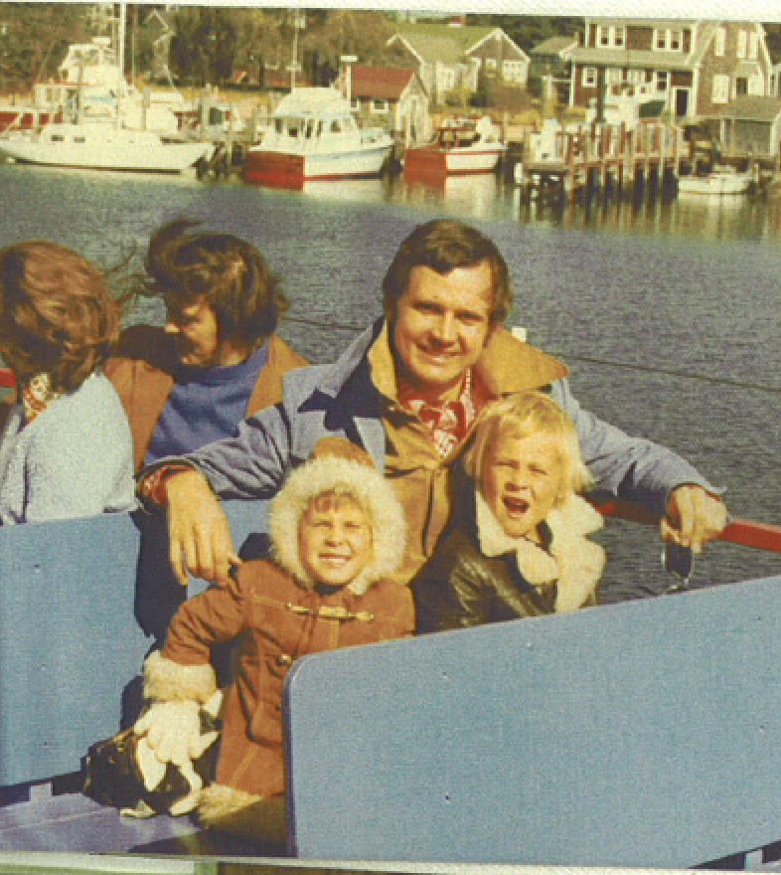
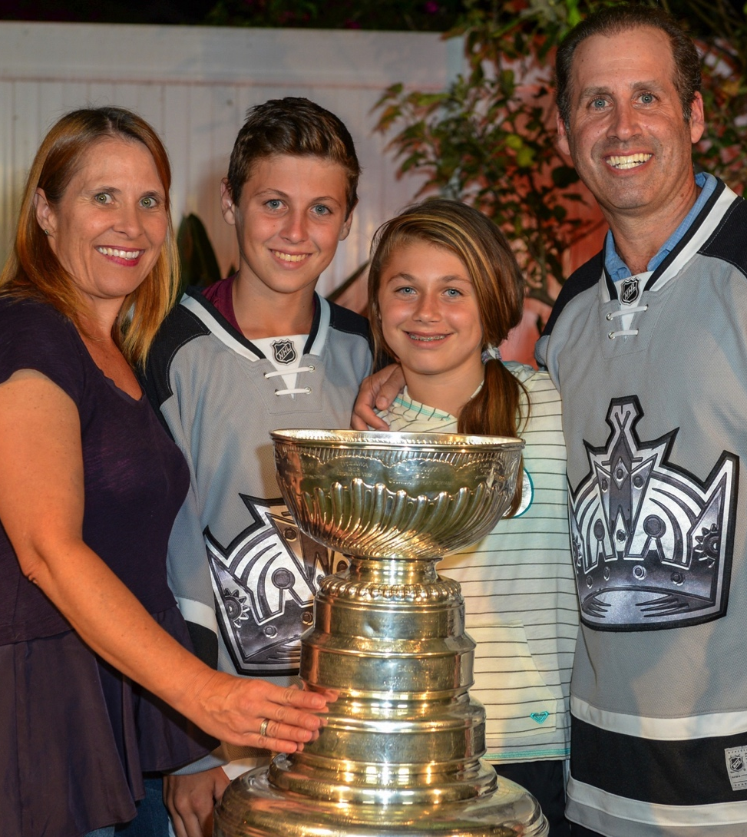
More Early Years…
A little about my family…Then & Now…
This is a picture of me with my father Dolliver and my brother Blayne (mom Joan was the photographer).
This is a picture of me, my husband Mark and my two kids, Justin and Amanda

Slide 6
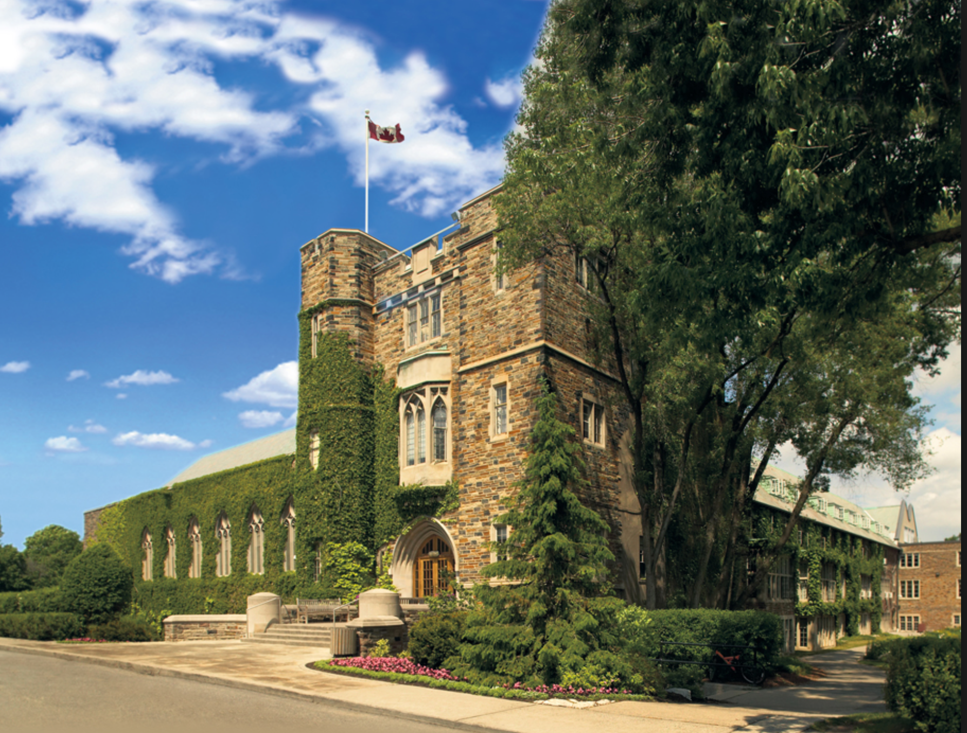
HIGH SCHOOL
I attended Havergal College in Toronto (you call it High School in the US).

Slide 7
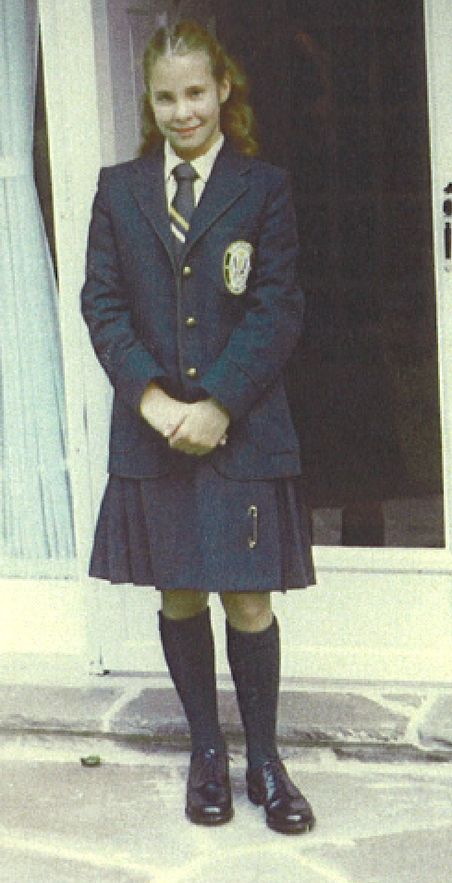
HIGH SCHOOL
As a HS student I was involved in
  Field Hockey
  Yearbook
  Band

Slide 8
HIGH SCHOOL
Things I enjoyed in HS
Things I did not enjoy in HS
Friends
Political Science (enjoyed the debates!)
Commuting – it took me 1½ hours to get to school!
All Girls School – way too much gossip and “BFF’s”
Latin

Slide 9

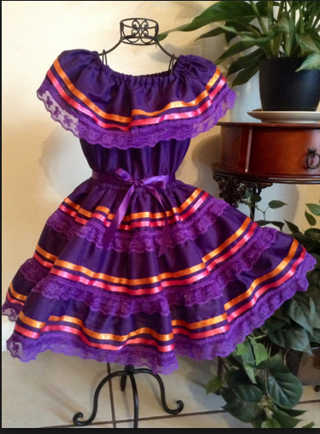
HIGH SCHOOL
Jobs I worked while in HS
Canada’s Wonderland – Restaurant Manager (lots of uniforms!)

Slide 10
HIGH SCHOOL
Fondest memories from HS
Obstacles I overcame in HS
Father Daughter Dance
Graduation!
Skiing/Swimming like everyone else (despite hip problems)
Juggling working weekends

Slide 11
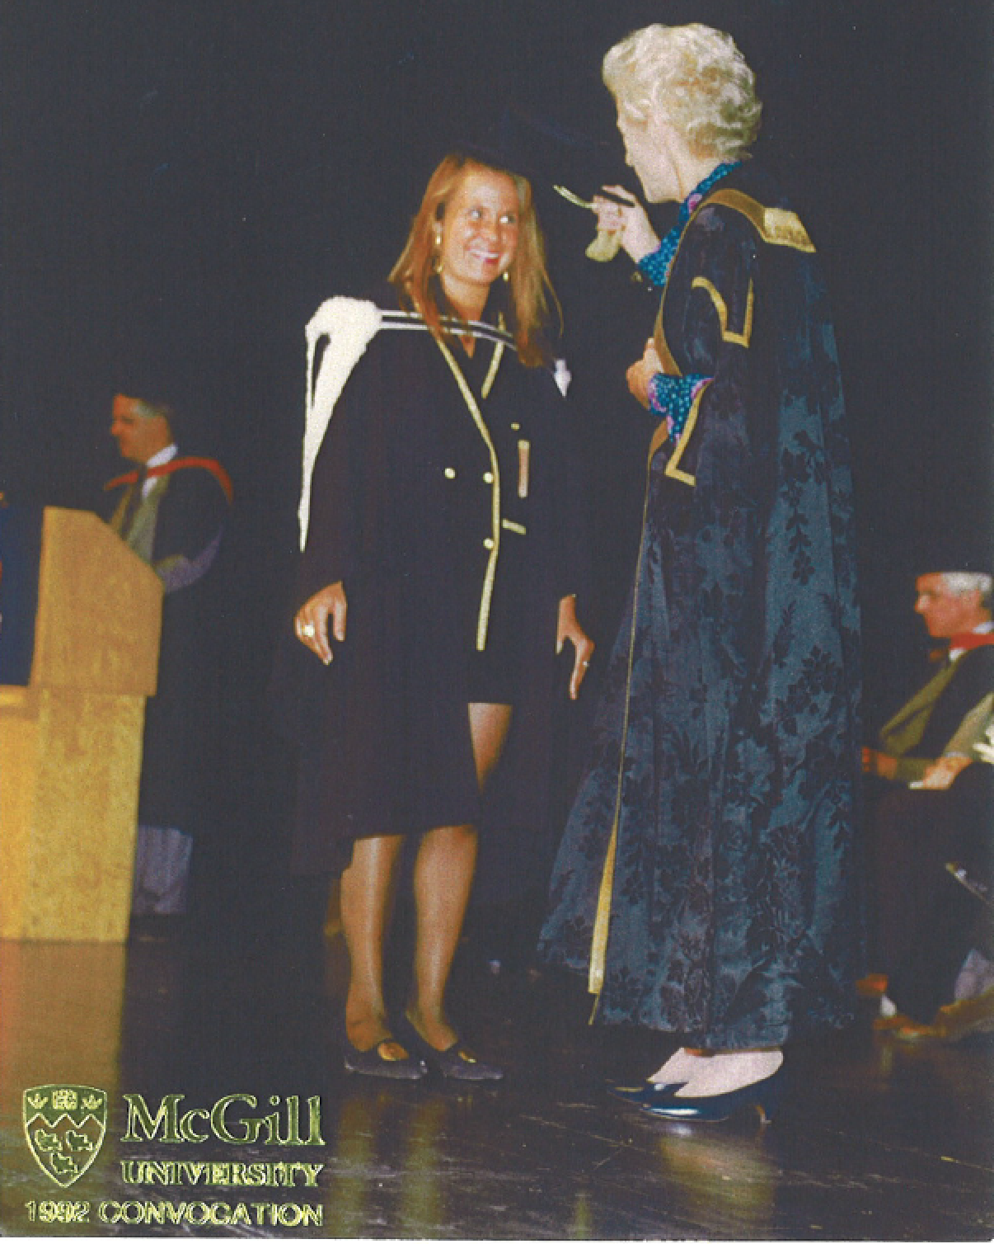
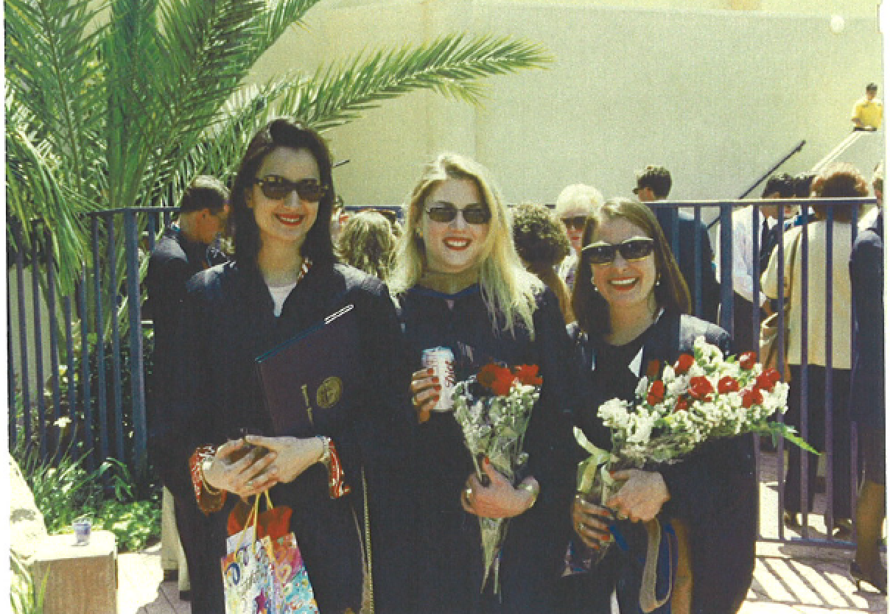
College &
Graduate School
I studied undergrad at McGill University in Montreal, Canada and then went to Pepperdine University in Malibu, California for business school

Slide 12

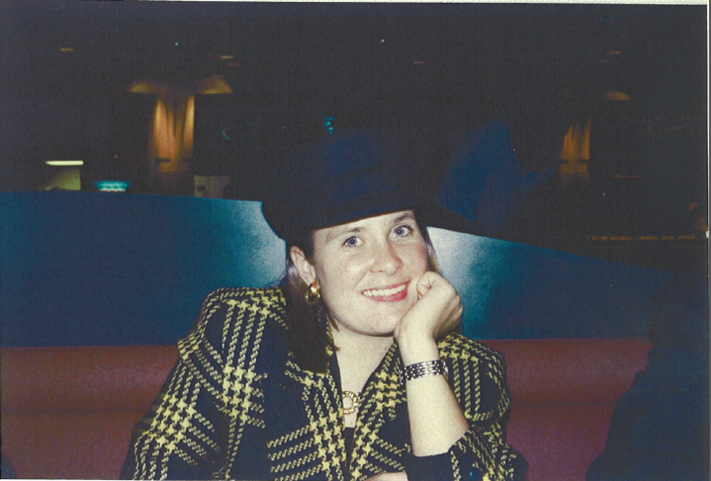

College &
Graduate School
I spent 1 year studying and working in Paris, France
I worked at a French Advertising Company -

Slide 13
College &
Graduate School
Fondest memories
Obstacles that you had to overcome
Working and Traveling oversees
Being independent and on my own
Car accident that almost stopped me from going to Paris
Being far from friends and family
Unsure of what I wanted to do after school, where to live as my parents moved from Canada to California

Slide 14



Career Path
I started in Advertising
I worked as a Sr. Licensing Manager at Disney Consumer Products
I worked as a Product Manager at Mattel Toys
I am now Licensing Director at Quiksilver Sportswear
Notes:
You may use this chart to describe your journey to the current career

Slide 15
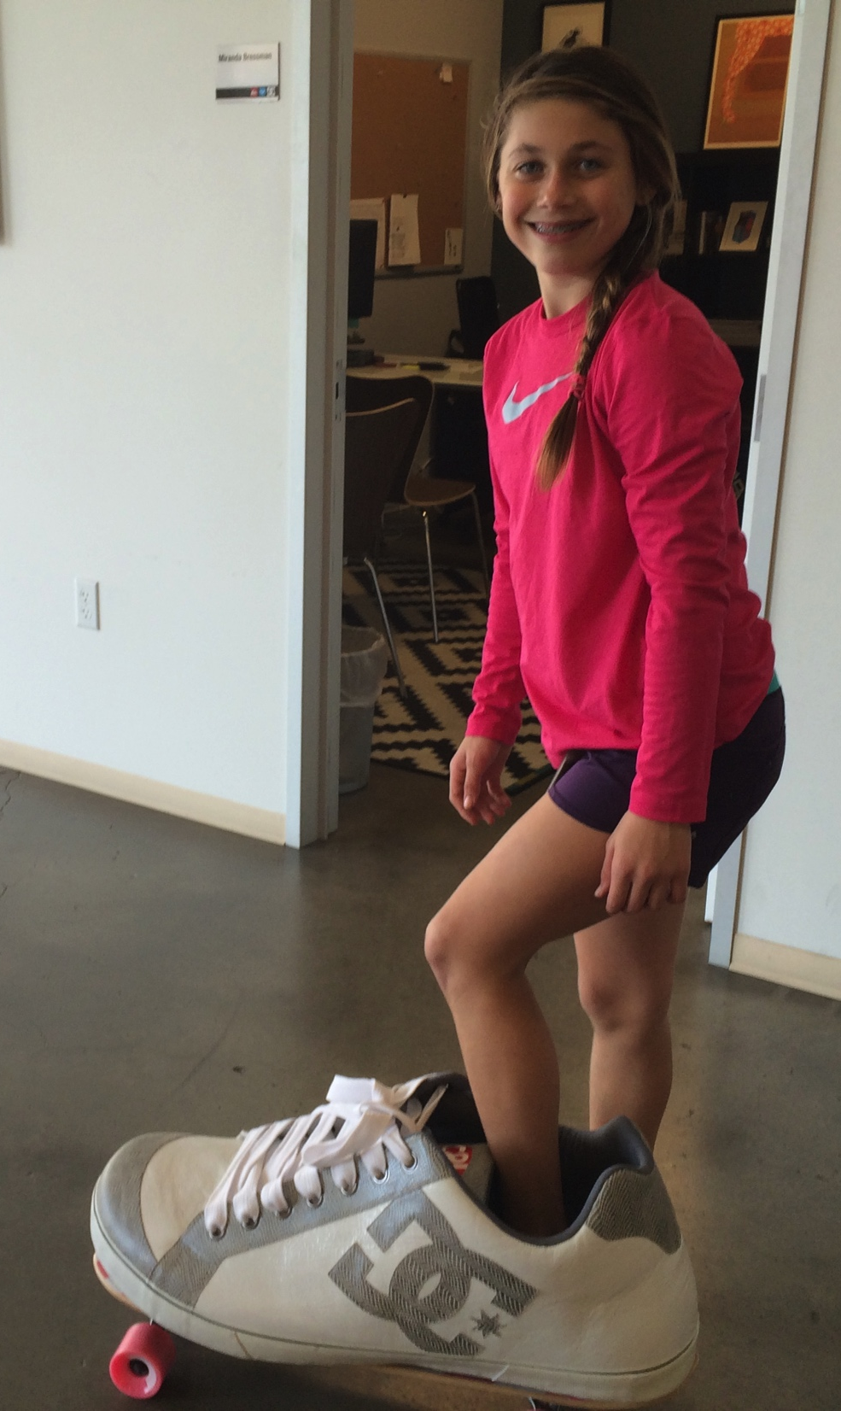
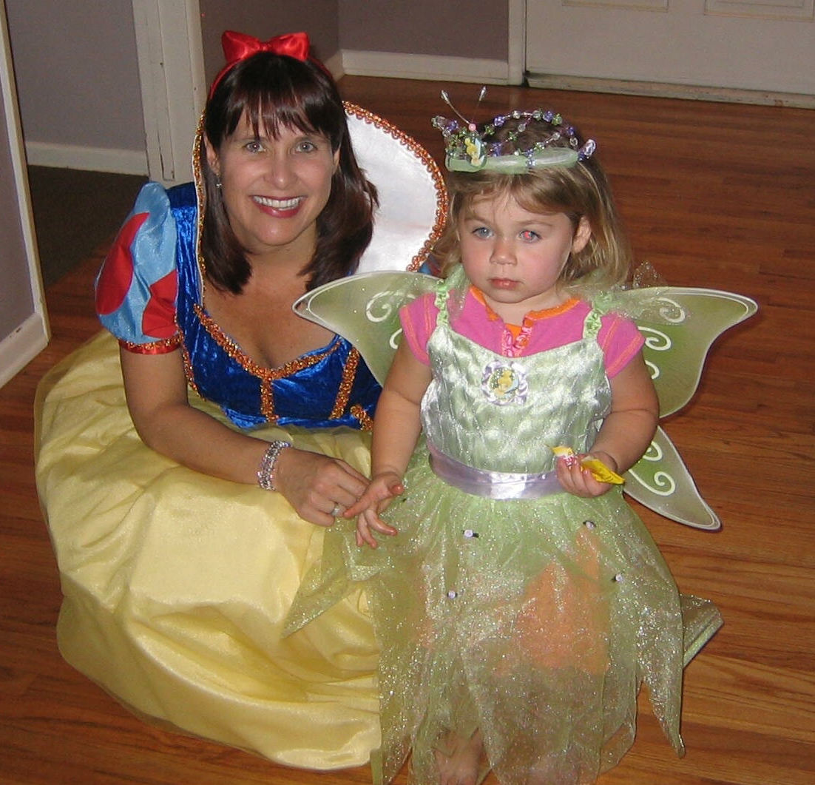
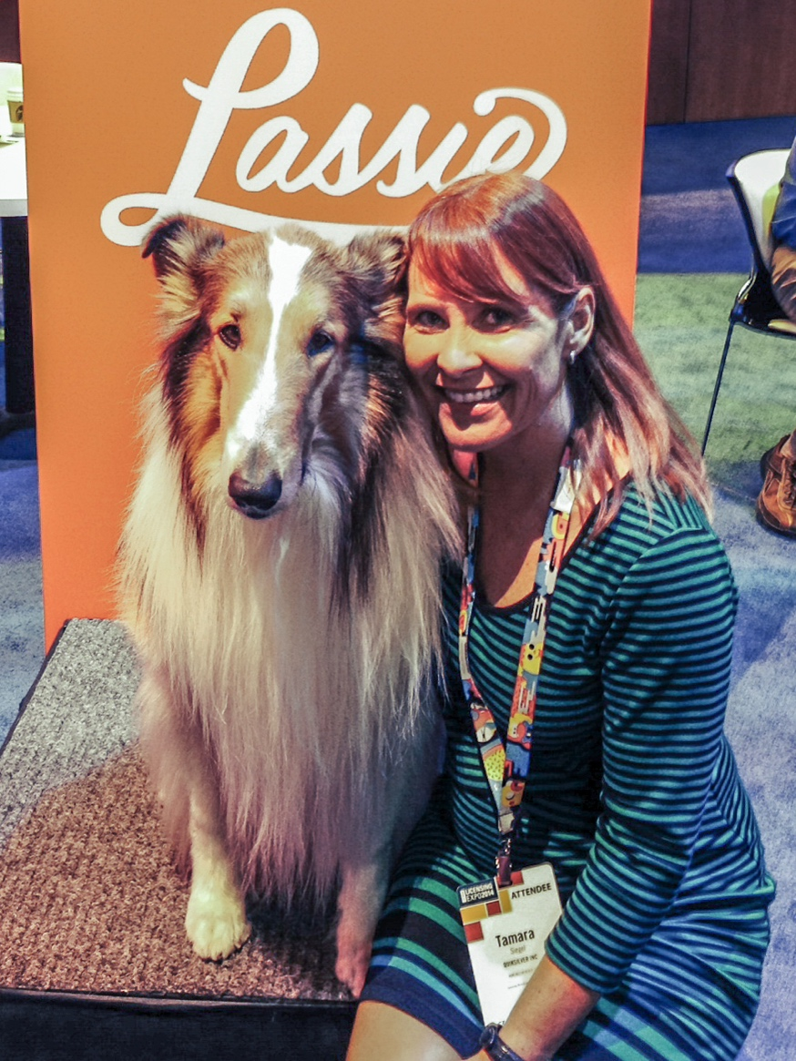
Career
Getting into my work!!

Slide 16
Career
The biggest work challenge I’ve had to overcome is :
Balancing my career with being a mother

Slide 17
CURRENT ROLE
History
Quiksilver was founded in 1969
Size
We have over 6,100 employees with sales over $350 million per year.
Location
Our headquarters is in Huntington Beach and we have offices in France and Australia.
Products
Services
We make sportswear under the Quiksilver, Roxy and DC Shoes brands
Notes:
Use this graph to give more description of your current company (history, size, location, products and services, etc.)

Slide 18
Current Role
Director of Licensing
Retailers
Design & Development
Product Licensees and Partners
Finance Departments
Notes:
Use this graph to give more description of your role specifically (responsibilities, typical work week, direct reports, etc.)

Slide 19
Career Compensation
Company Management $100k-$400k
Brand & Business Managers
$75k-$100k
Design & Development
$50k-$80k
Administrative $40k-$60k
Notes:
Use this graph to show general compensation ranges for people in various roles in your company

Slide 20

QUESTION AND ANSWER

